Slide 1
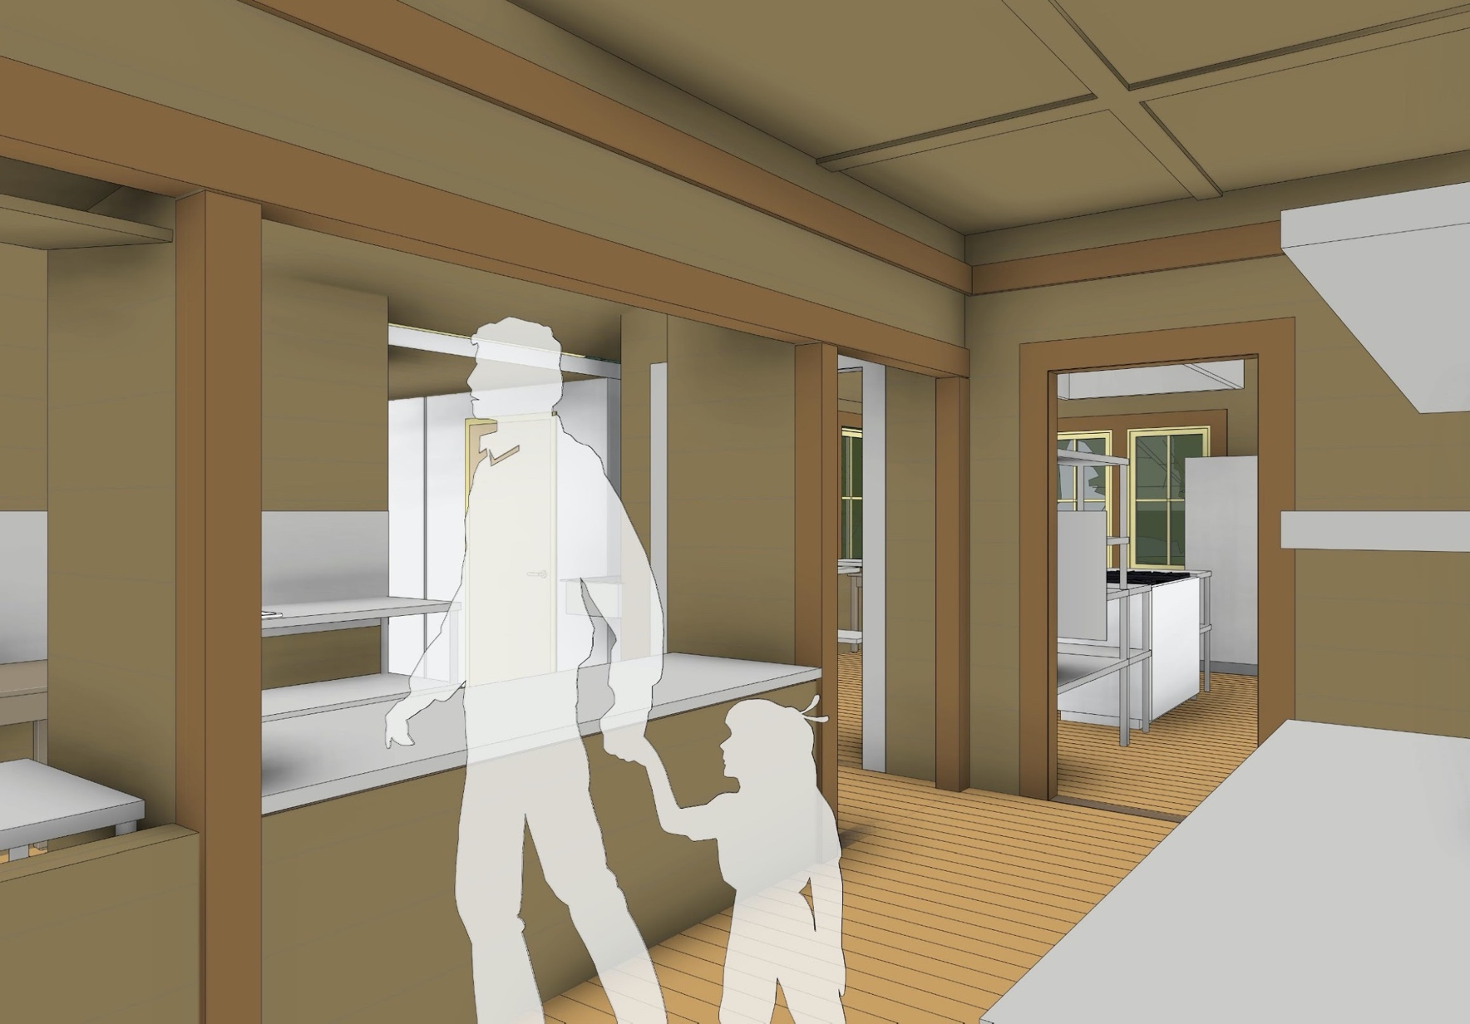
serving pantry
Notes:
This is a close-up of the service area, or serving pantry, where guests can pick up their food during times of self-service (Extension and the shoulder seasons).

Slide 2
Summary of PWWG East Design Advantages
Accessibility
New Bathrooms | Two ADA compliant bathrooms which are accessible from the dining room and from service road. Located to take advantage of natural ventilation.
Dining Room | Access from north road, 5% accessible seating (four seats) without loss of seating capacity.
Notes:
Accessibility is improved with two new ADA compliant bathrooms with entry from inside and outside the building and in the dining room.

Slide 3
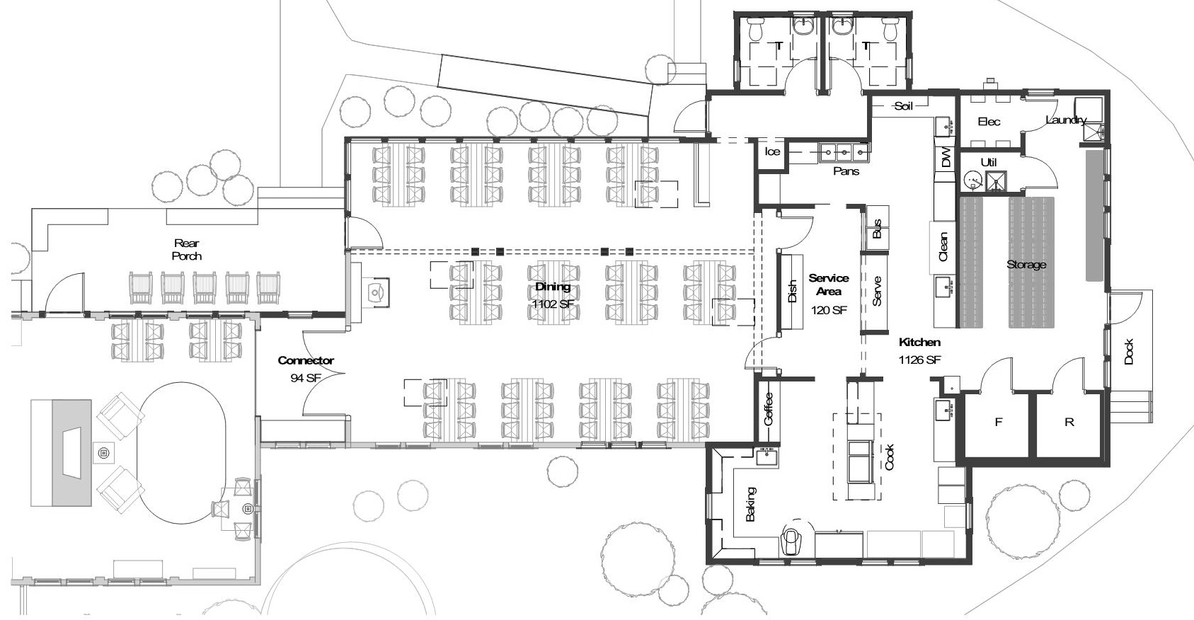
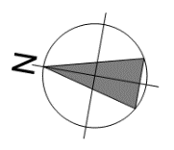
new bathrooms
enlarged plan
Notes:
The east plan also provides space for two new ADA compliant bathrooms. These bathrooms can be accessed through a short hallway off the dining area as well as from outside the Lodge with a ramp leading to door into the hallway.

Slide 4
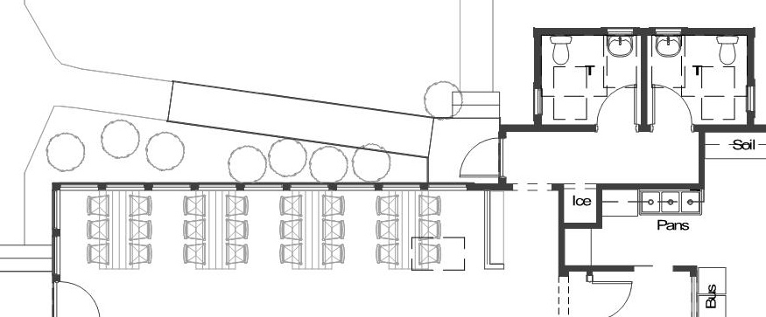
new bathrooms
Notes:
This provides you with a sense of the access to and location of the two new ADA compliant bathrooms. They can be accessed from the northeast end of the new dining area, or from outside on the north side of the building.

Slide 5
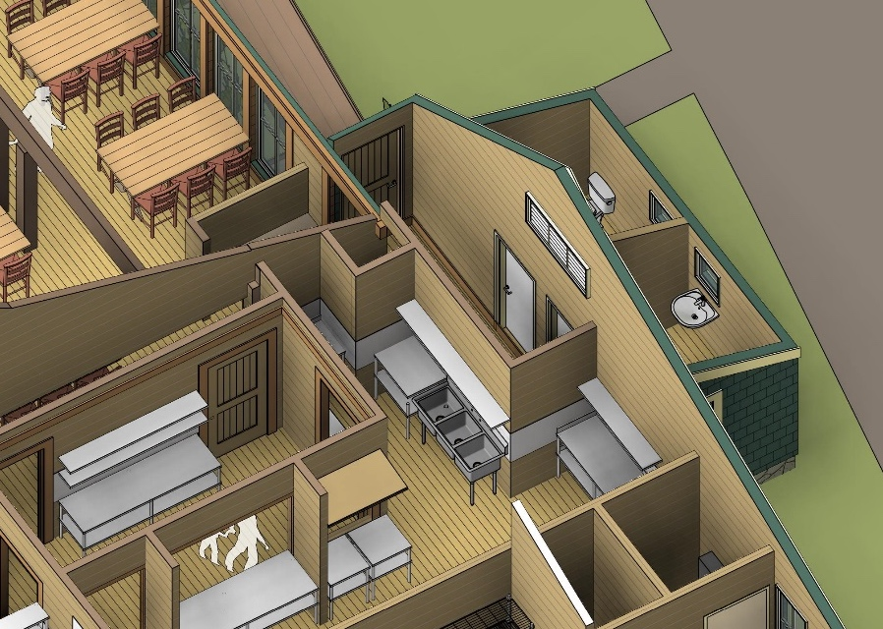
axonometric
Notes:
Here is better view of the bathrooms and their accessibility. Also note, they are positioned to maximize the use of natural ventilation.

Slide 6
dining room layout
Notes:
Now let’s take a closer look at the dining room. The structure of the new dining room resembles the existing dining area as you will see in the next few slides.

Slide 7
Summary of PWWG East Design Advantages
Dining
New Dining Room | Repurpose original/existing kitchen shell for new dining area with new north porch-type addition similar to current north dining porch
Continue Architectural Integrity | Traditional materials, stains, and timbers to create a new dining room with a similar feel to existing dining areas.
Table Layout Options | Anchored” tables ends to wall or columns with options for additional layout. Serving continues at end of each table
Additional Circulation Area | Additional space between tables and serving aisle widths that exceeds code minimum and provides for slightly less crowding.
Notes:
A new dining room with a similar look and feel to the existing dining area will repurpose the space of the old kitchen. The table layout provides anchoring of tables, and additional space for ease of entry for guests.

Slide 8
Summary of PWWG East Design Advantages
Dining
Improves acoustics and sight lines | Use of double columns and low beam differentiates space while allowing guests to hear and see speakers. Acoustic panels between rafters absorbs sound.
Service | Similar serving travel distances to the current dining area. Server tray stand storage also provided.
Notes:
The new dining area will have improved acoustics, good visibility of the speaker for all guests, and similar travel distances to current dining for crew.

Slide 9
new dining room
enlarged plan
Notes:
The new more spacious dining room is located inside the upgraded structure of the old kitchen. It maintains the current dining seating space of 12 tables of six people each. The existing dining area is not ADA compliant, but this new dining space will be ADA compliant with space for at least four wheel chairs (or over 5.5% of the available seats, above the ADA requirement). There will also be more space between the tables allowing for easier access.

Slide 10
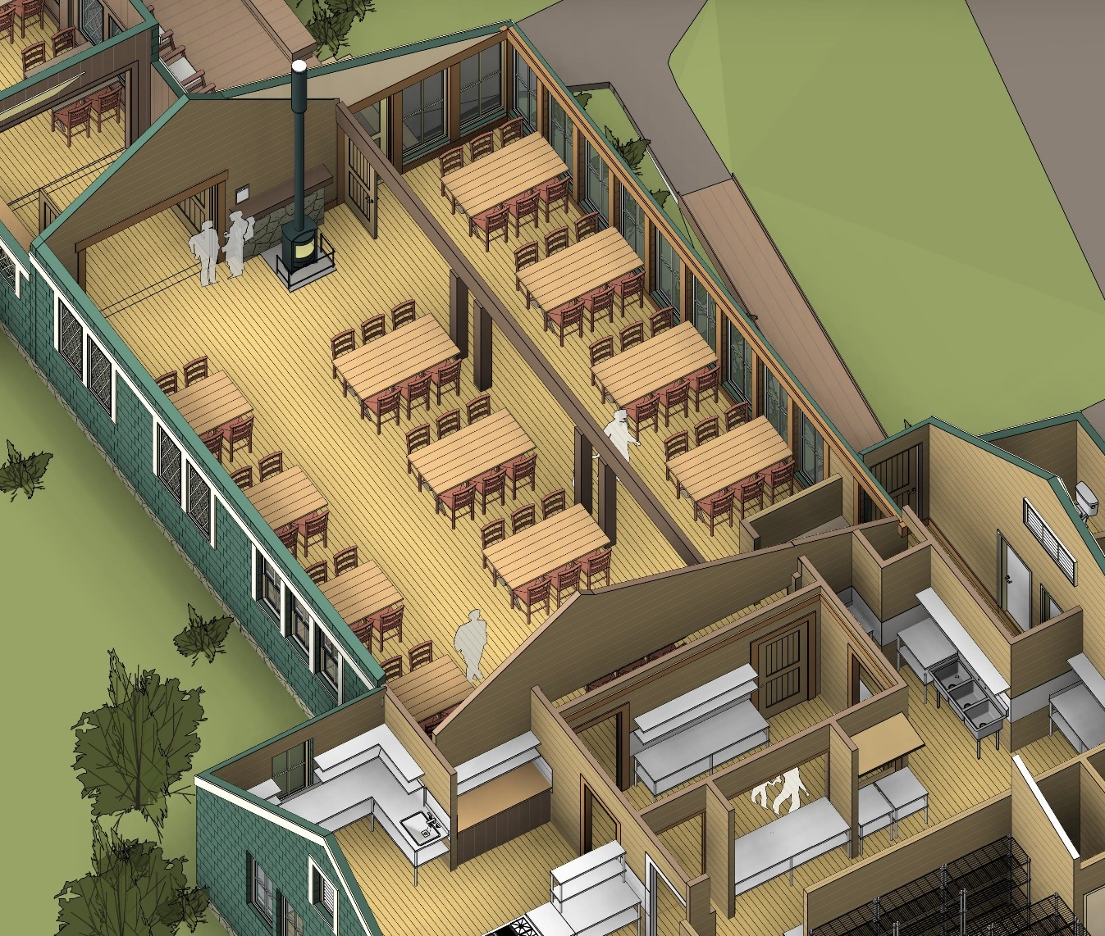
axonometric
Notes:
This is a view of the dining room showing the 12 tables with six people at each table adjoining the new kitchen. Eight of the tables are anchored by the north or south walls.
This area has a small wood stove at the western end. Announcements would be made near the stove, and the speaker would have clear visibility to all of the 12 tables in the dining area. This should result in an improvement in the ability of guests to hear more clearly.

Slide 11
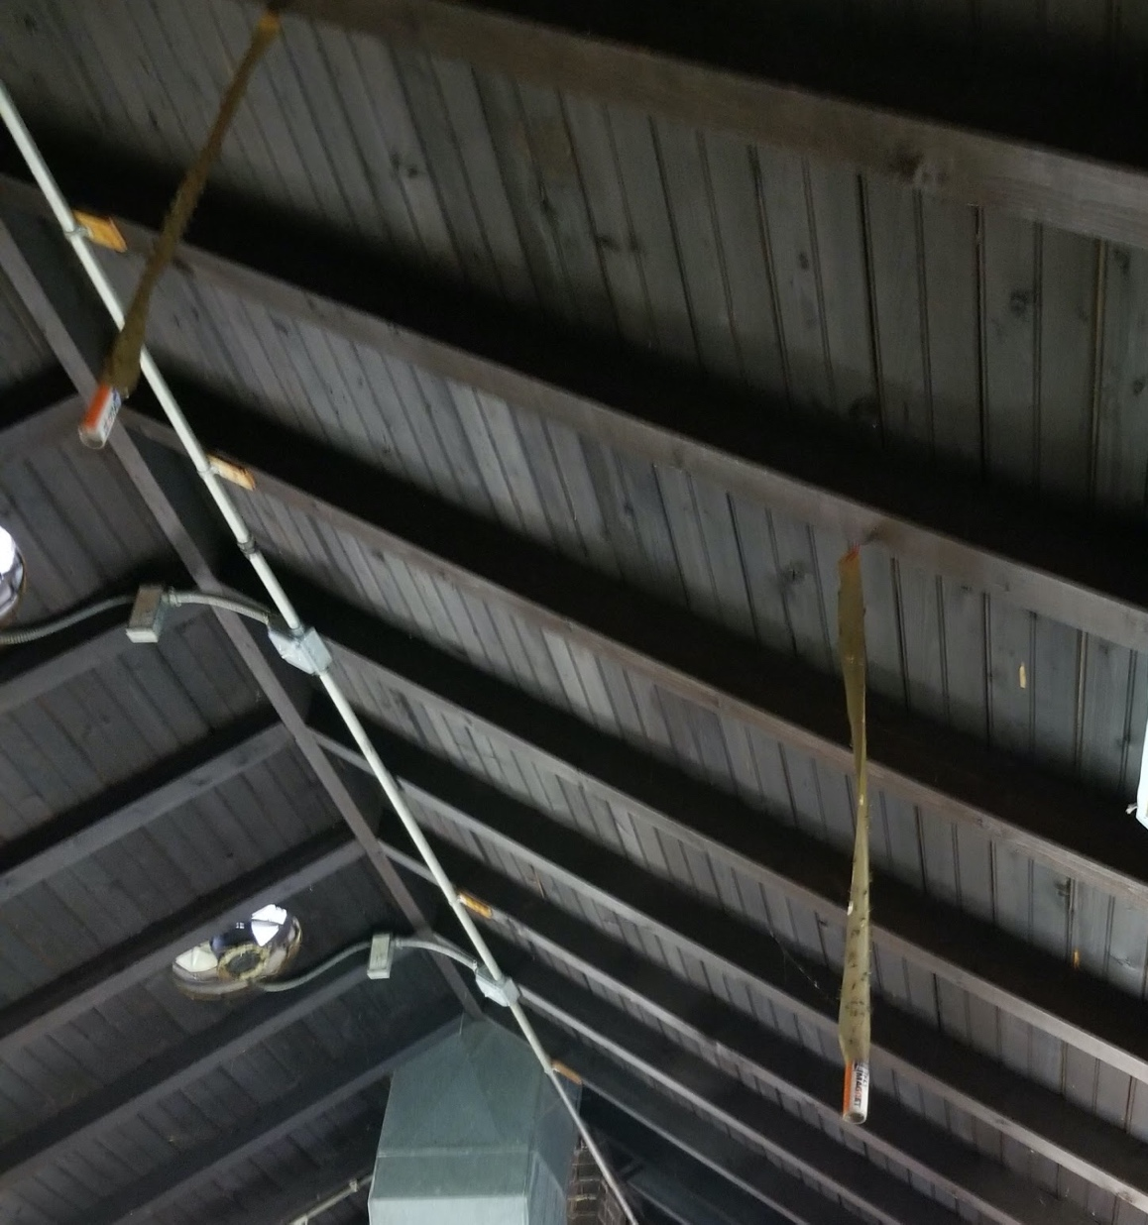
retain existing
kitchen roof
structure
historical 3” x 4”
rafters with
tongue and groove beadboard
sheathing
Notes:
The new dining room will retain the current kitchen roof structure. This is a photo of the current kitchen roof from the inside.

Slide 12
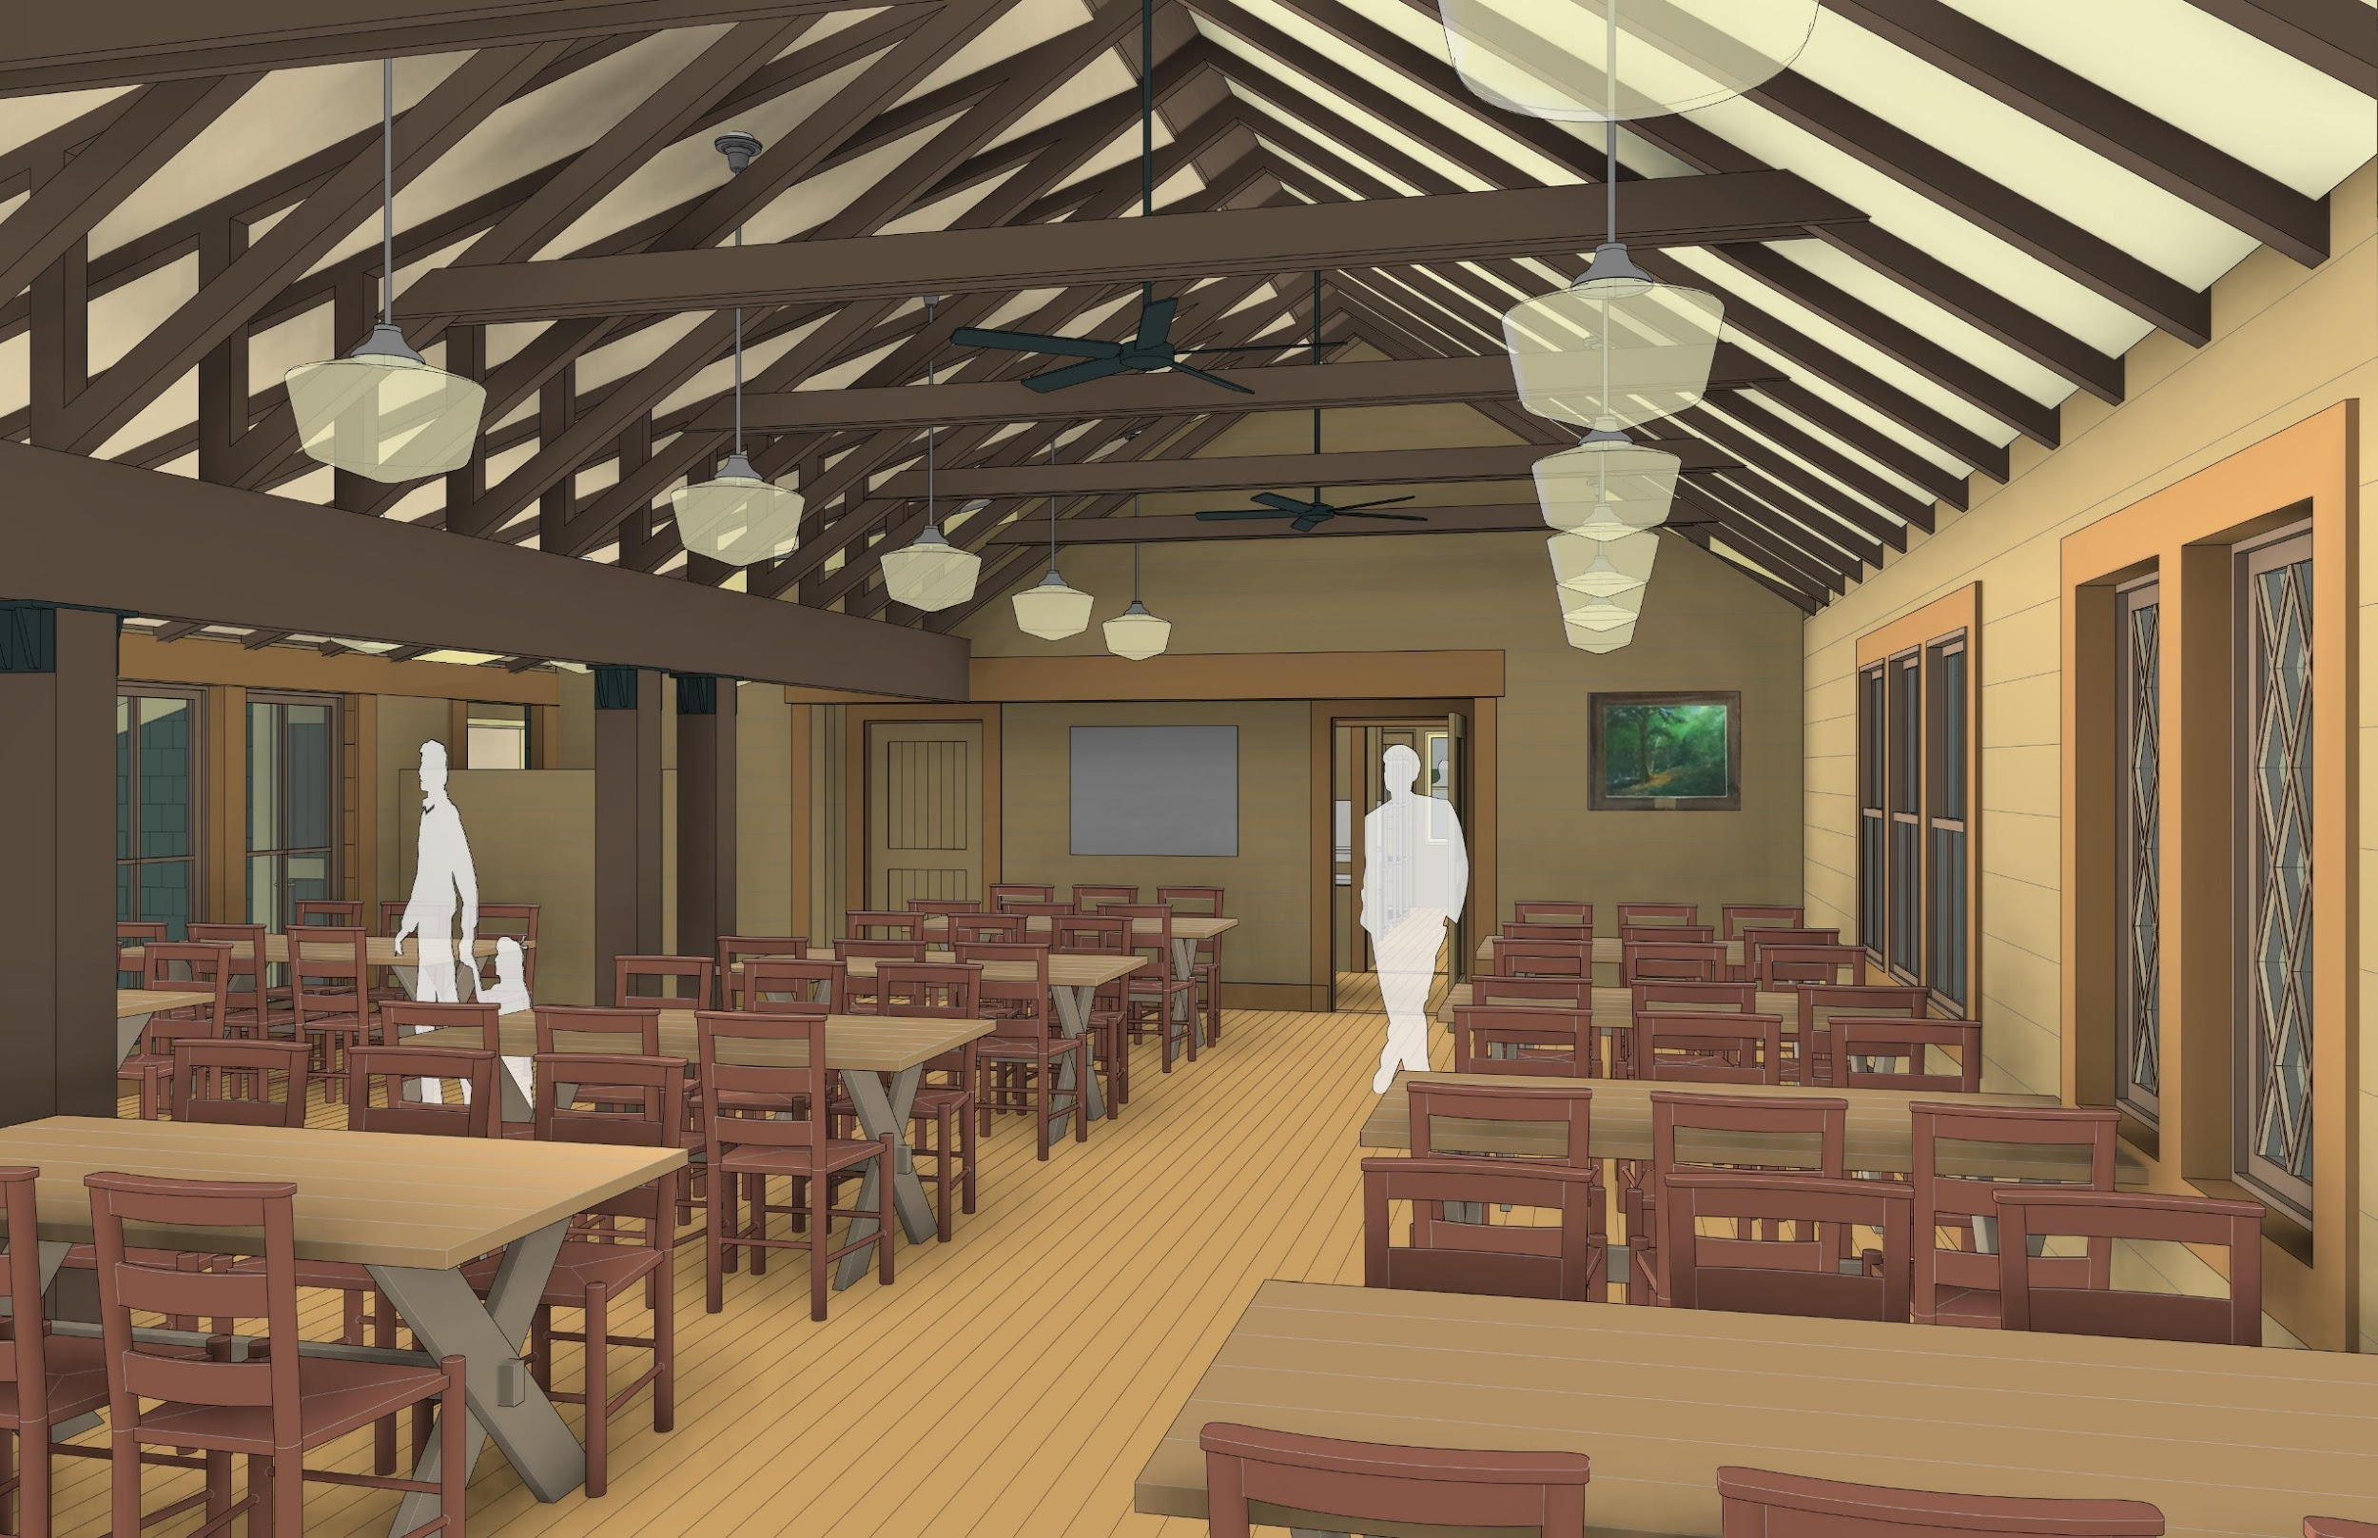
dining
view
east
Notes:
This is looking toward the east into the new dining area, showing the ceiling structure. We plan to place the appropriate sound dampening material in this room to control the overall level of noise. The doors that you see in the back lead into the new kitchen.
Though one dining room, there will be three main areas: an alcove-like area to the far left in this view, which is similar to the dining porch; a center section, and the southern section in which the tables are anchored by walls/windows on the right.

Slide 13
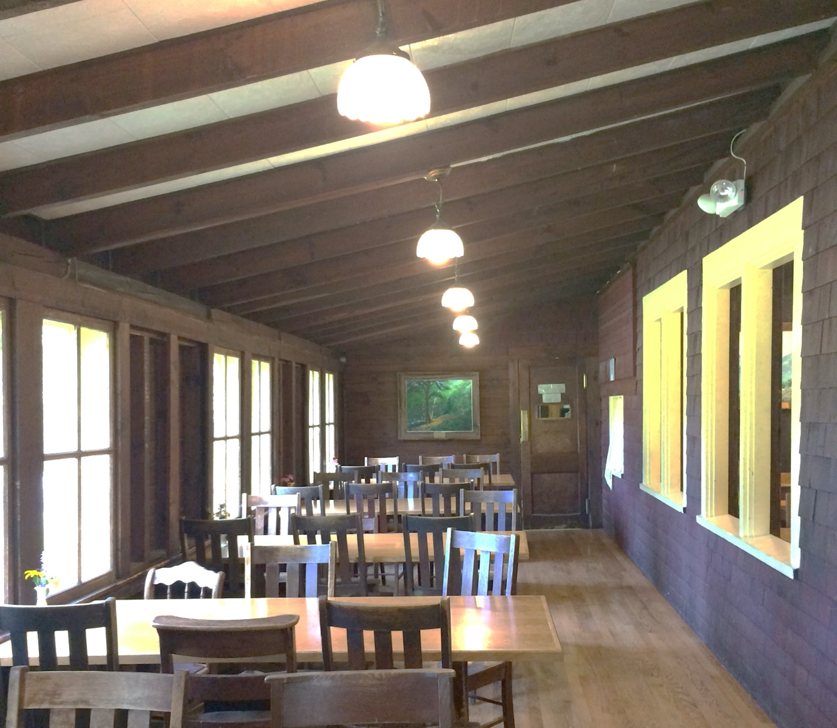
existing porch
view
east
Notes:
This is a recent picture of the dining porch looking east.

Slide 14
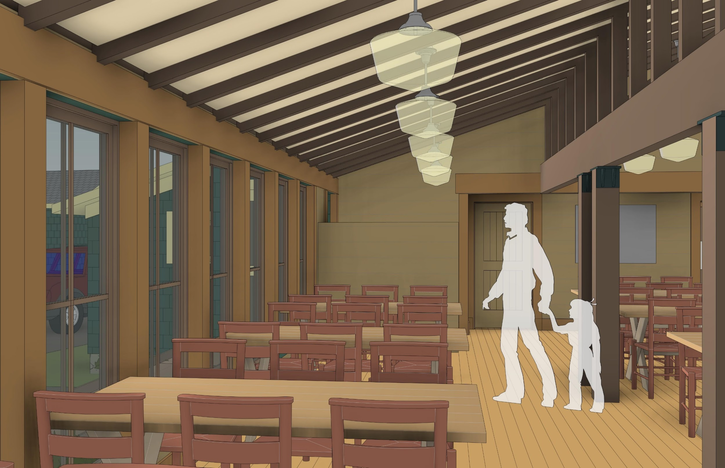
new
dining
view
east
Notes:
Here is the same view within the new dining area. In some ways, this area is will mirror the old dining room porch area.

Slide 15
sidebar alternatives #1: dining room center anchor wall
center tables anchored on half-wall vs. unanchored center tables
Add a half-wall ensuring that every table is wall anchored?
This feature replicates the current dining porch half-wall and helps to break up an institutional dining hall for a more intimate domestic dining room.
Notes:
All of the design slides that you have seen so far were recommended by the architects. The Lodge Planning Committee formerly approved of these plans in a Committee vote on June 15, 2019. There were only three minor areas where the Lodge Planning Committee and the PWWG architectural design plan differed. We will quickly discuss these in the following sidebars.
The PWWG plan envisions eight of the twelve tables anchored to a wall/window. Of the remaining four tables in the middle of the dining room, two would be anchored by double pillars but two tables would have no anchor.
The Planning Committee agreed to create a low half wall between the two pillars in the center to provide an anchor and help break up the potential institutional feel.

Slide 16
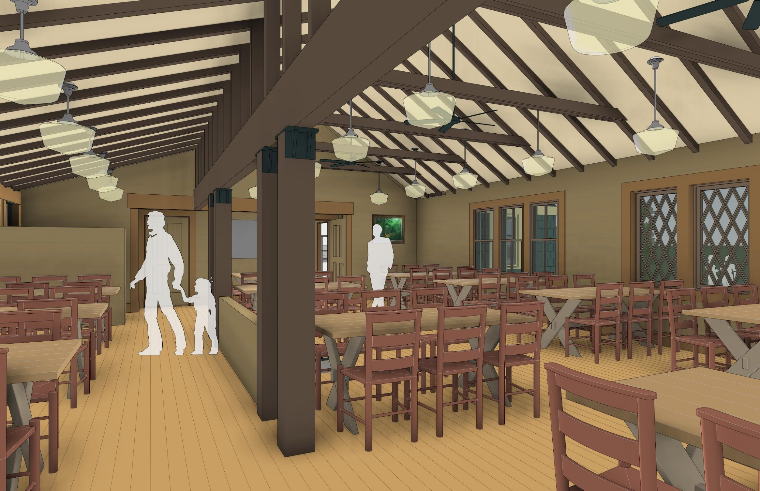
dining
view
east
low half wall
Notes:
Here is a view showing the low-half wall.

Slide 17
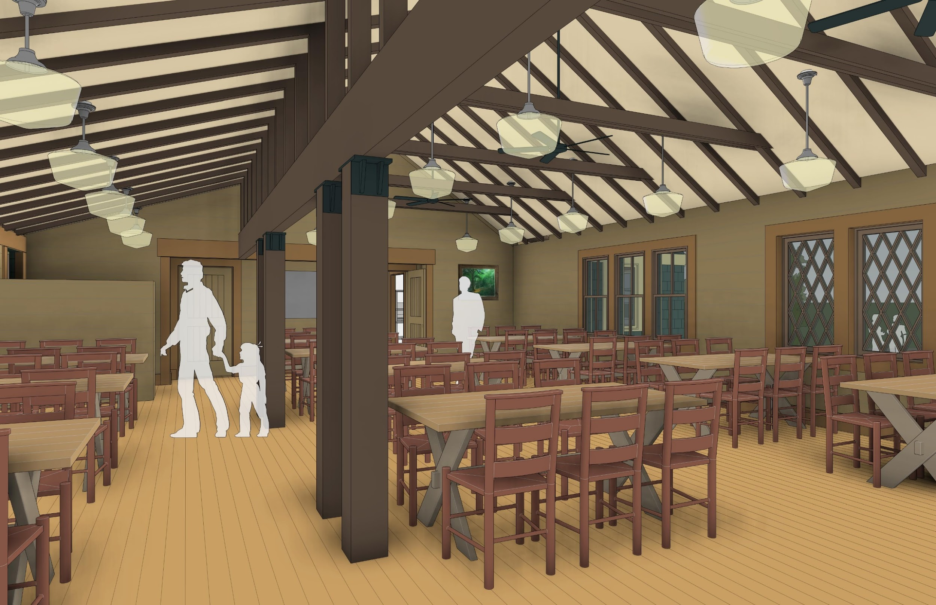
dining
view
east
Notes:
For comparison, here is the view without the low-half wall, which was in the original PWWG recommendation.
Let us know at the end of the presentation if you have comments/suggestions regarding the half wall.

Slide 18
sidebar alternatives #2: dining hall stove locations
west vs.
center vs.
southeast
Where best to provide stove heat, to keep guests safe, to maintain good crew workflow, and to help break up institutional dining hall for a more intimate domestic dining room feel?
West? Center? Southeast?
Provide heat, keep guests safe and good crew workflow, and help break up institutional dining hall to maintain dining room feeling
Notes:
The PWWG plan recommended a center-located stove in the dining area. They felt this would be the most heat-efficient location, and could serve as a gathering spot during non-meal times. The Lodge Planning Committee decided for safety and other reasons that a west-located small wood stove would be preferable. One other possibility is a south east location.

Slide 19
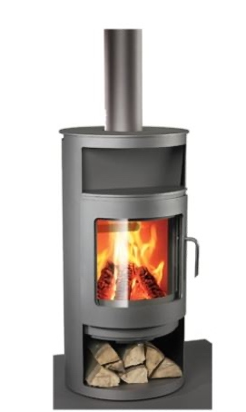
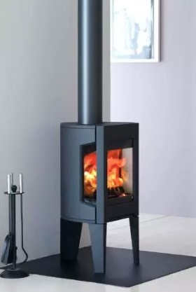
type: wood burning stove
coverage: 1100 sf min.
small footprints: 20” x 20”
safety: typically glass is the only surface to get hot – verify with mfg.
select decorative unit, especially if back of unit is exposed
dining room stove
Notes:
This is just an example of the type of wood stove that is being considered. We will need to do further research before making a final decision.

Slide 20
west
stove
Notes:
Here is location of the west stove in the floor plan.

Slide 21
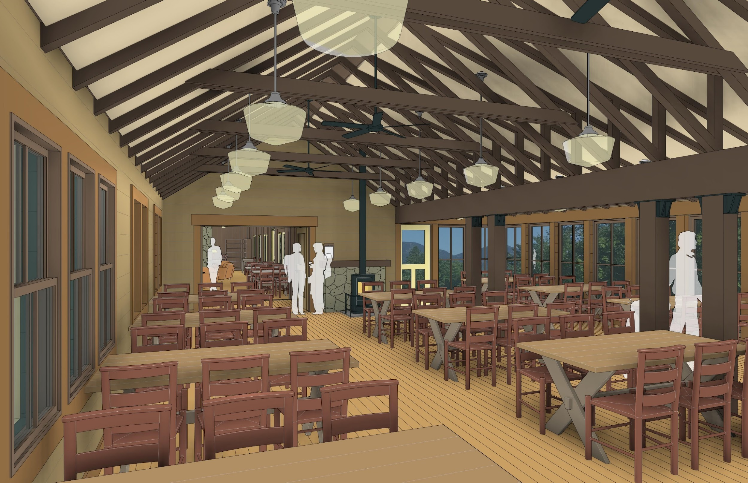
dining
view
west
Notes:
Here is a view looking at the west stove next to the entrance. The speaker before meals would stand to the left of the stove to make announcements.

Slide 22
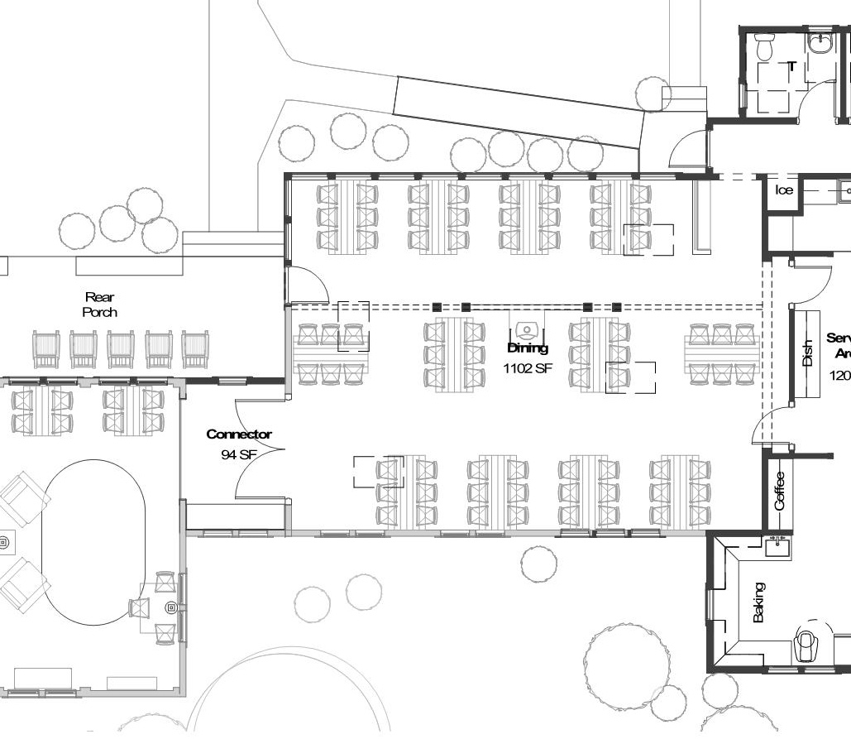
center
stove
Notes:
A center located stove would provide more efficient heating, but would be near guest tables.

Slide 23
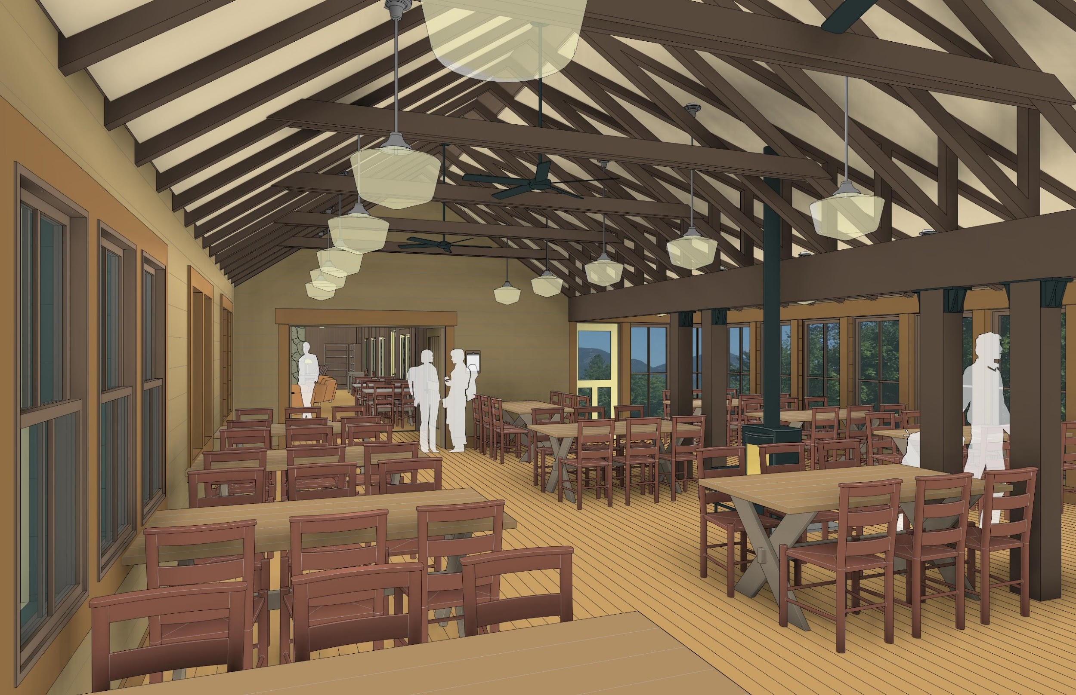
dining
view west
center
stove
Notes:
Here is a view of the center located stove

Slide 24
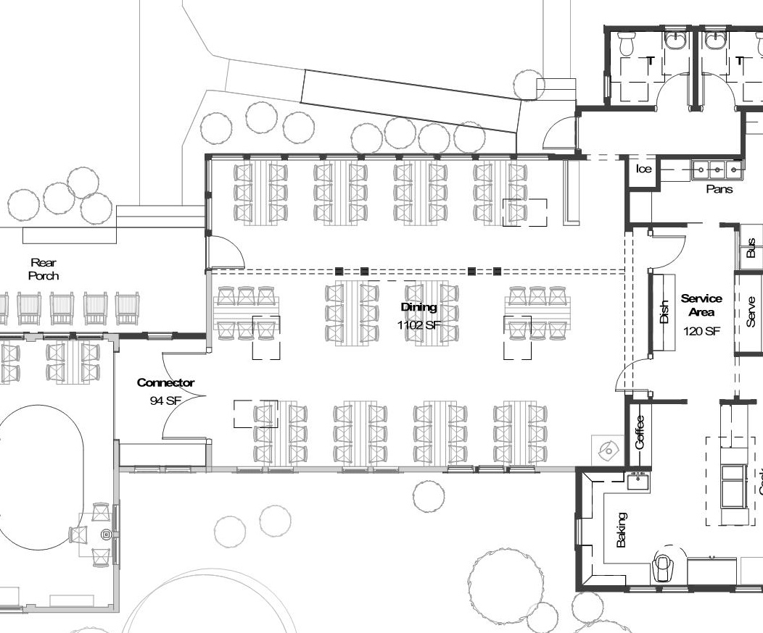
southeast
stove
Notes:
Another possible stove location is in the southeast corner.

Slide 25
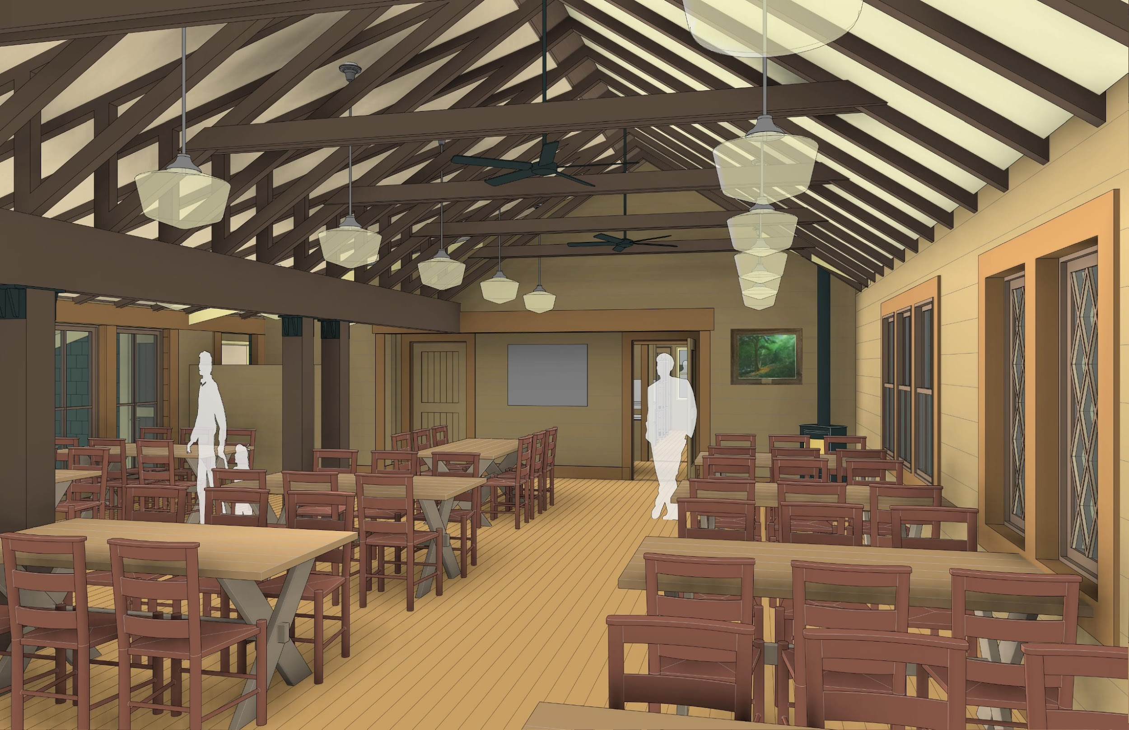
dining
view east
southeast
stove
Notes:
View of the southeast located stove from inside the dining room.
Do you favor the West location or do you have another opinion? Let us know at the end of the presentation.

Slide 26
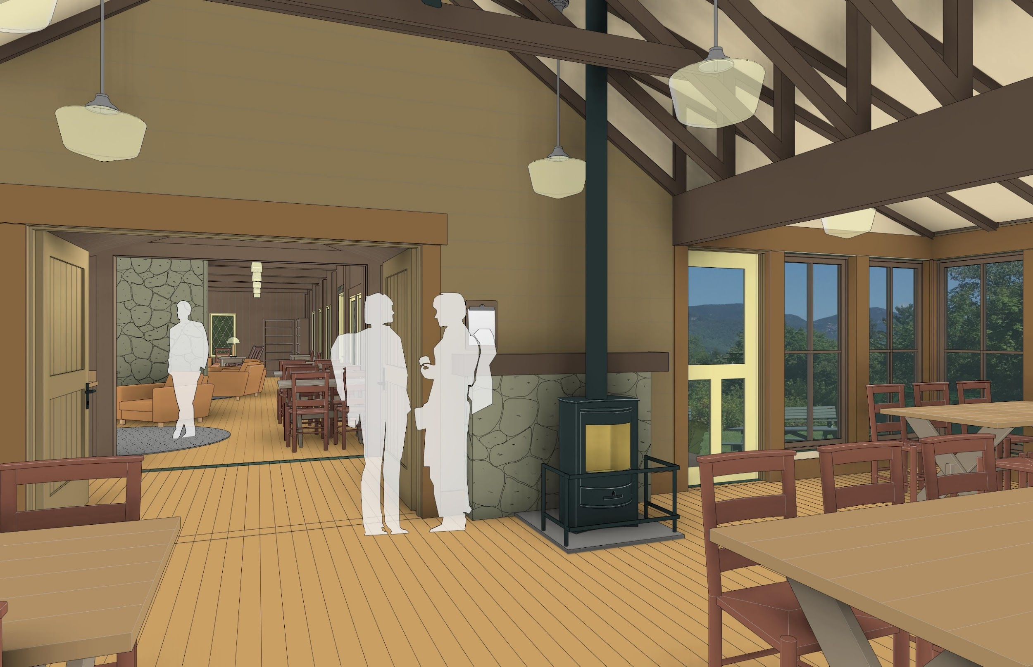
dining
view
west
Notes:
Let’s get ready to go into the Lodge. Before we go, here is a view at the west end of the dining area looking into the new multi-use social area behind the fireplace in the Lodge.

Slide 27
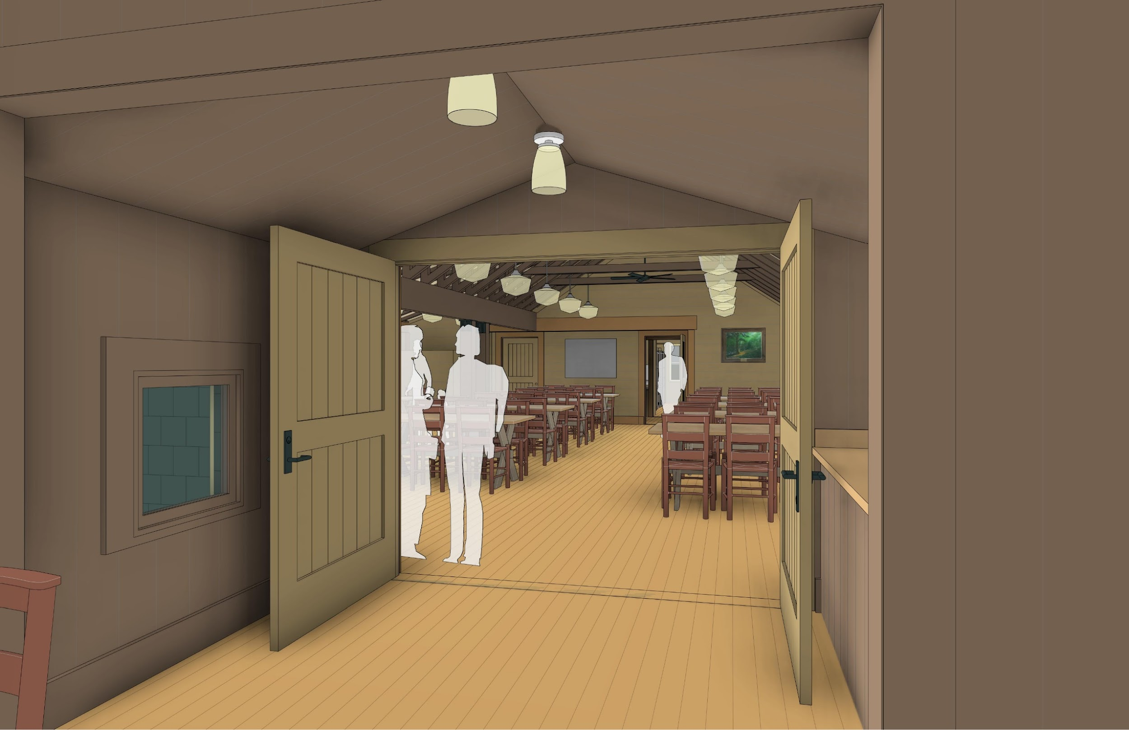
dining
view
east
Notes:
Here is the short walk-thru from the Lodge multi-use social area into the new dining room. Note: the large doors, which will largely remain open, are fire doors, as required by code. No sprinkler system will be needed.

Slide 28
main lodge layout
Notes:
Now we will switch gears, and focus on the main Lodge layout.

Slide 29
Summary of PWWG East Design Advantages
Social Area/Lunch Packing
Relocates trail lunch packing | Relocates portable lunch packing functions and guest cubbies to the east area of the fireplace with direct adjacency to dining room and servers.
Expands social area | Increases ability for informal seating at west end of Lodge and a new social area east of the fireplace.
Increases guest social places | Adds a north porch and fireplace east into the guest mix
Notes:
The new design expands the social space and relocates the trail lunch packing area. It also provides guests with a north outside uncovered porch.

Slide 30
expanded social area
enlarged plan
Notes:
The social area of the Lodge will be expanded greatly as the area behind the fireplace can now be a multi-use space with enough room for the trail lunch and for social space.
The trail lunch tables will remain temporary in nature (assembled in early morning, and removed in late morning) providing for extra room during most of the day.

Slide 31
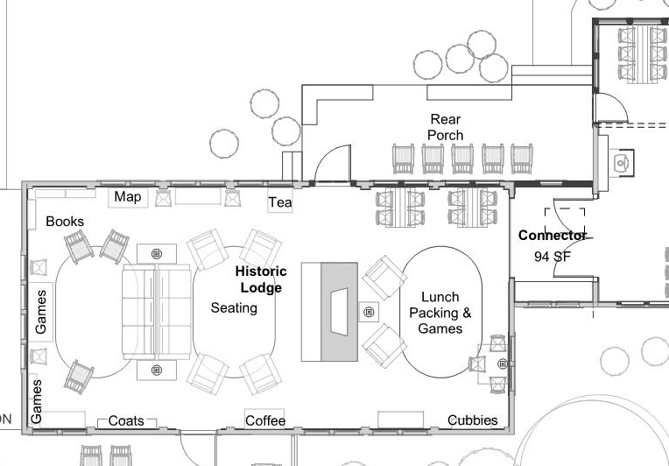
main lodge plan - east
overall plan
Notes:
Here is a floor plan highlighting the main Lodge in the east plan. Let’s focus on the area behind the fireplace, which was formerly a dining area. As you can see, there is an entrance into the new dining area (1). You can go out to the back of the Lodge through a door to the rear porch (4).
This area will serve as a multi-use space, though most of the time it will serve as a mainly a social area. There is space for the trail lunch tables, which will be removed by late morning. The cubbies that were formerly in the northwest corner of the Lodge will be moved into the southeast corner providing easy access for the morning trail lunches, and added space in the west end of the Lodge..

Slide 32
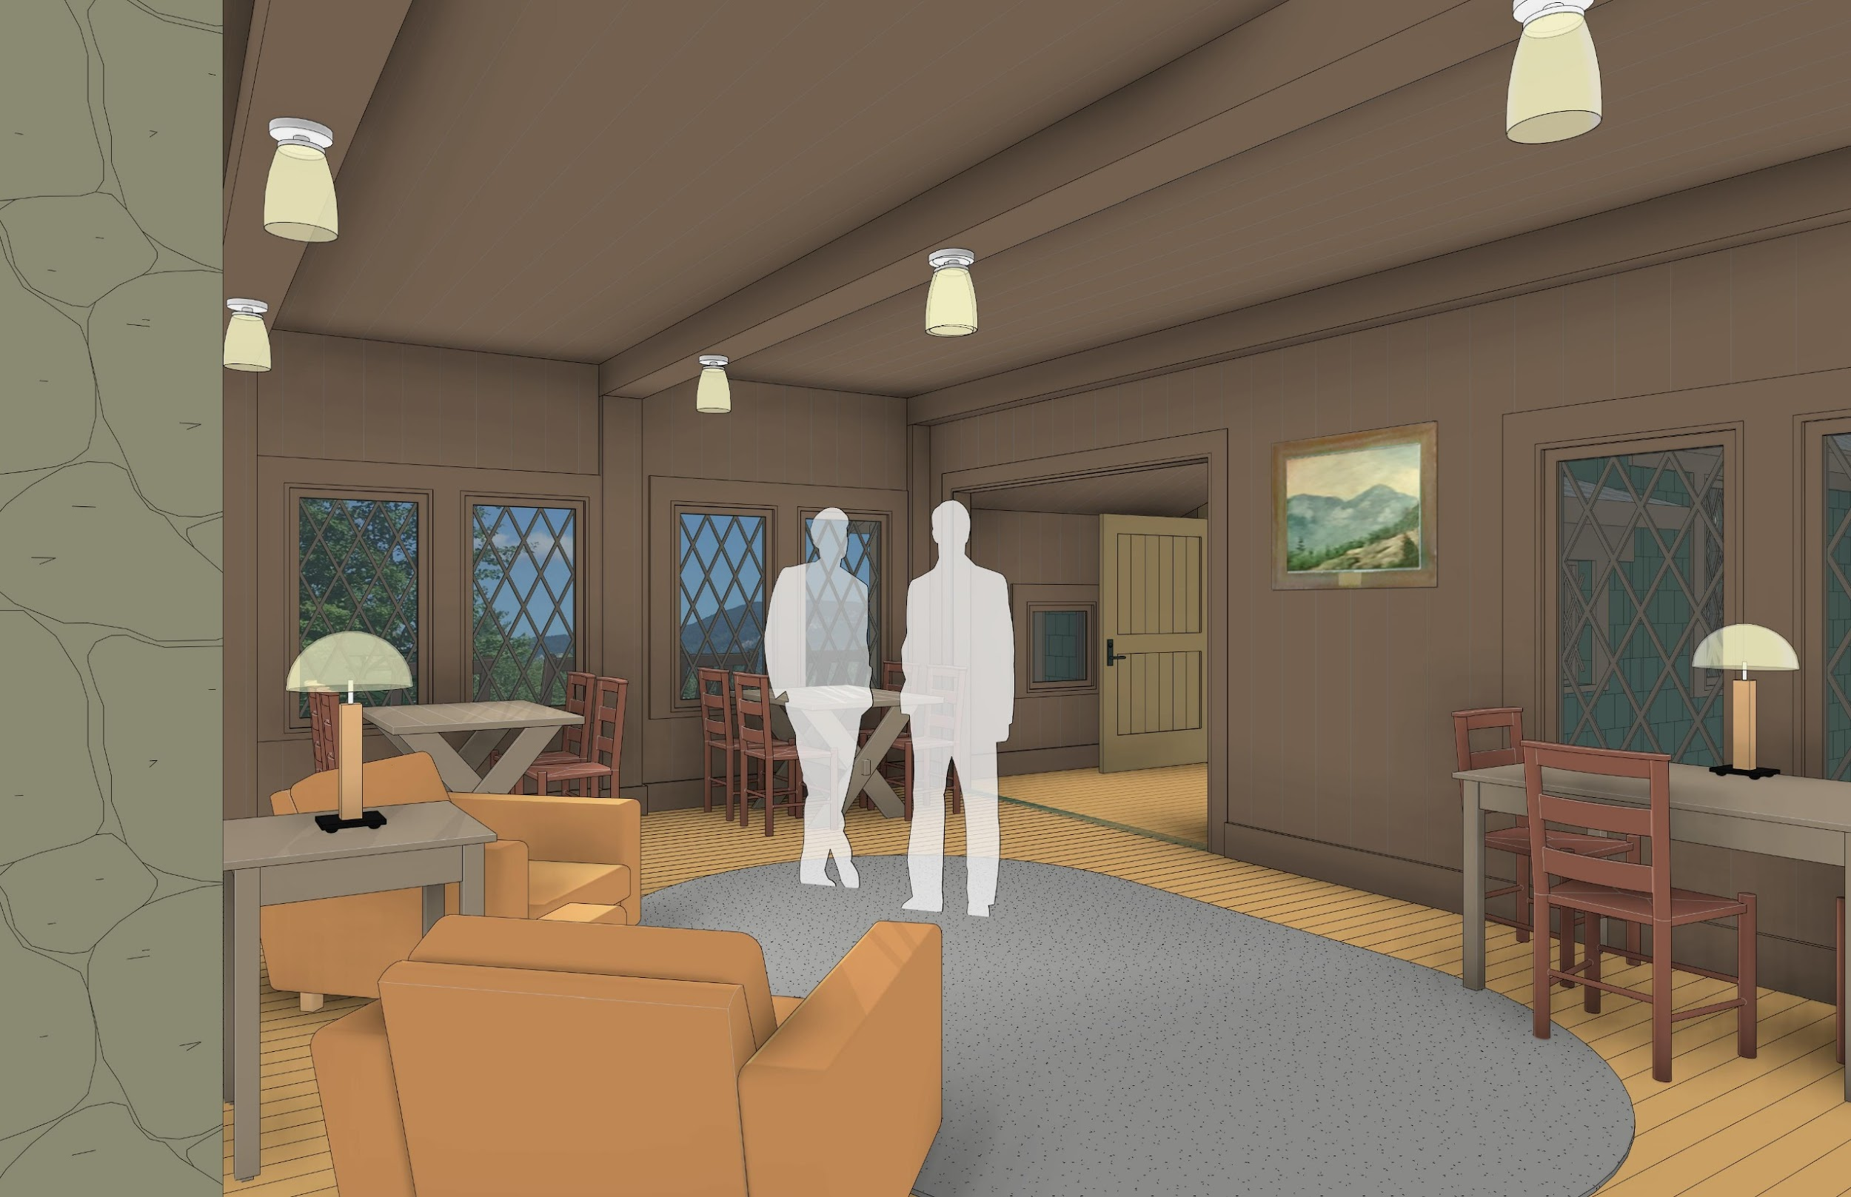
fireplace
east
area
Notes:
This area behind the fireplace in the Lodge was previously used as a dining space. This will be a multi-use space that will include a social area during most of the day. The trail lunch tables (which might eventually include temporary cold tables) will be here before and slightly after breakfast, and then removed until the next day.

Slide 33
remove old dining porch & restore original lodge
enlarged plan
Notes:
The old dining porch, which has major structural issues, will be removed. This will result in the return of the north wall of the Lodge closer to its original 1908 configuration with improved northward views.

Slide 34
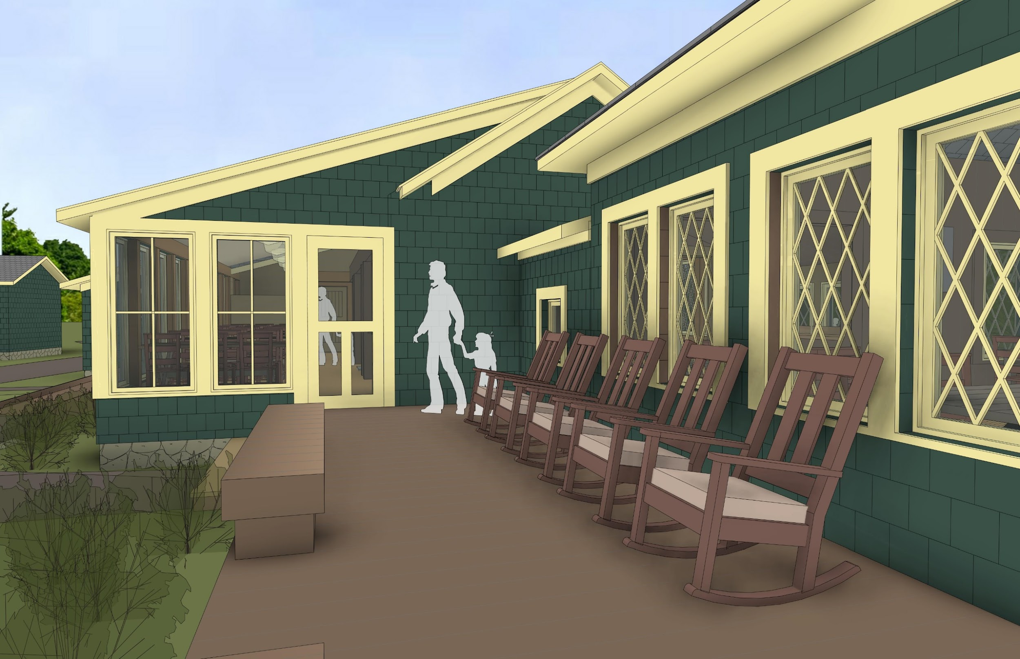
north porch
Notes:
If we exit the new multi-use social area into the back of the Lodge we arrive at a new outdoor north porch.

Slide 35
sidebar alternatives #3: solar photovoltaic locations
east & south vs.
east only
Solar panels are scalable.
There are multiple placement options for solar panels around Camp.
Should solar panels be placed on south roof? Or not here to help preserve the rustic aesthetics of camp?
Notes:
Based on preliminary work of the Lodge Planning Committee, it was determined that we would need to have 60 solar panels at Camp to meet most of CRC’s electrical load. The architect’s plan involved having panels on both the south and east roofs of the new dining area and kitchen. The Planning Committee leaned toward having them only on the east roof.

Slide 36
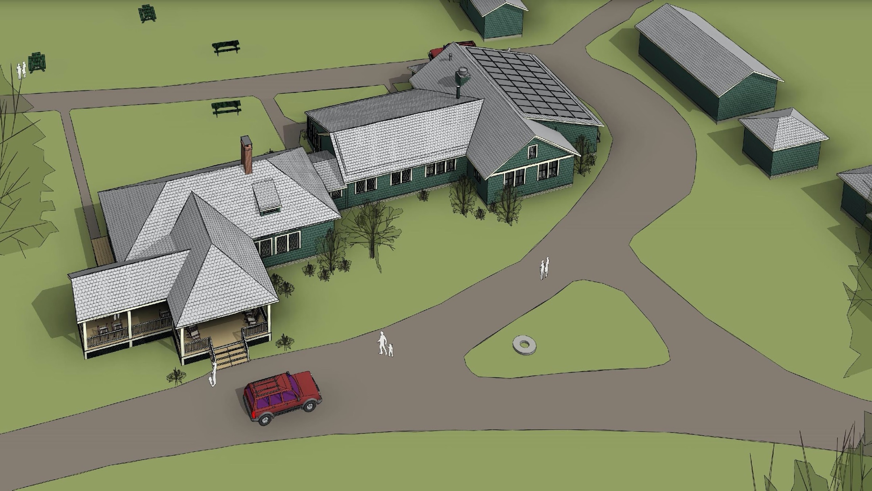
south aerial – with east facing solar panels
Notes:
Here is a view showing the solar panels only on the east roof.

Slide 37
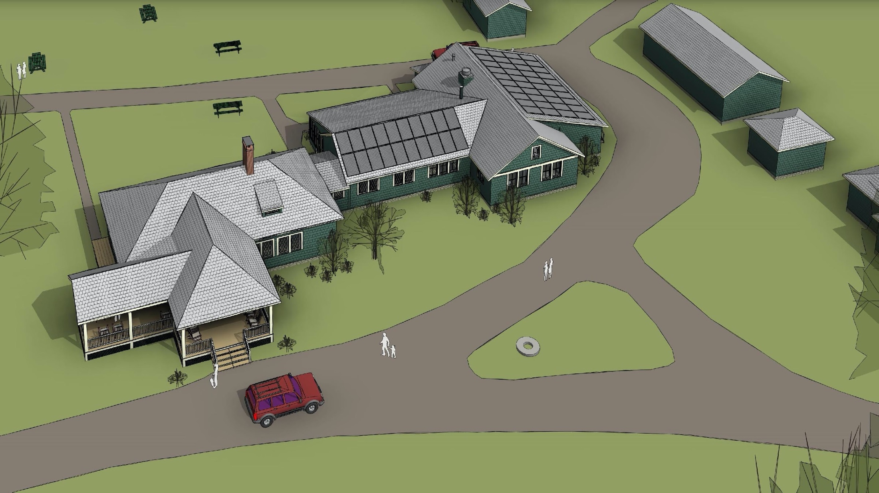
south aerial - with south and east facing solar panelsl
Notes:
Here is aerial view with solar panels on both the south and east roofs. Please note that the panels on the east roof will not operate as efficiently as those on the south roof due to the direction and path of the sun during the day.

Slide 38
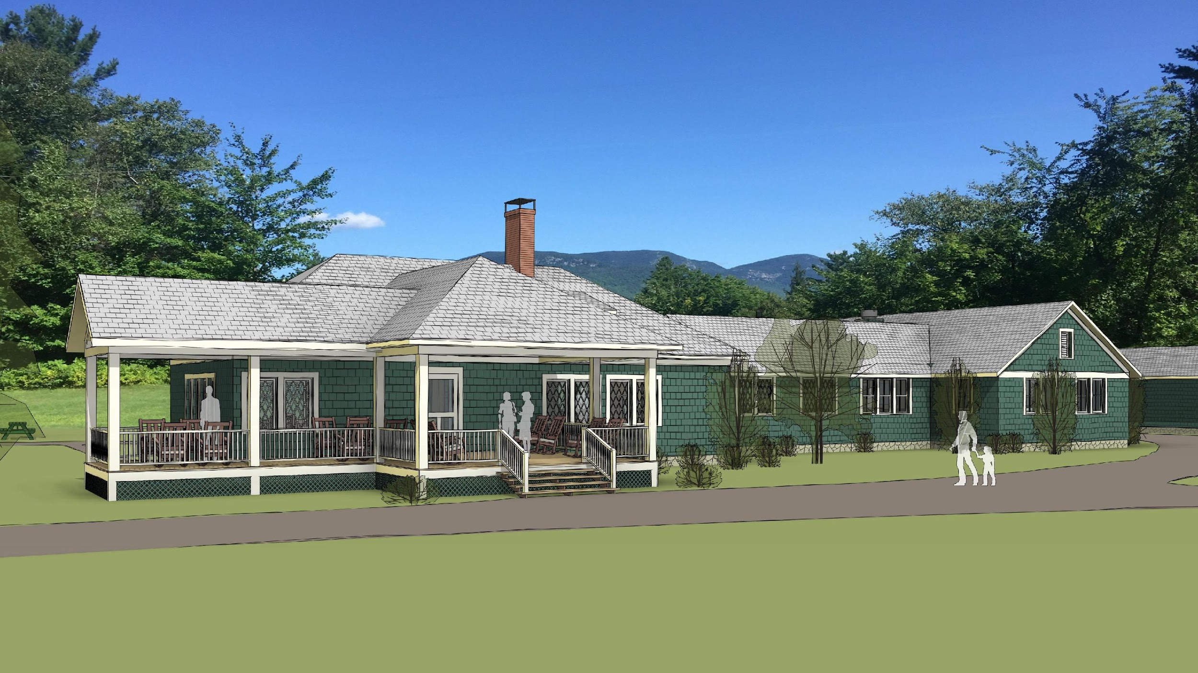
southwest view – with east facing solar panels
Notes:
This is what you would see if you were looking directly at the Lodge with the solar panels on the east roof only.

Slide 39
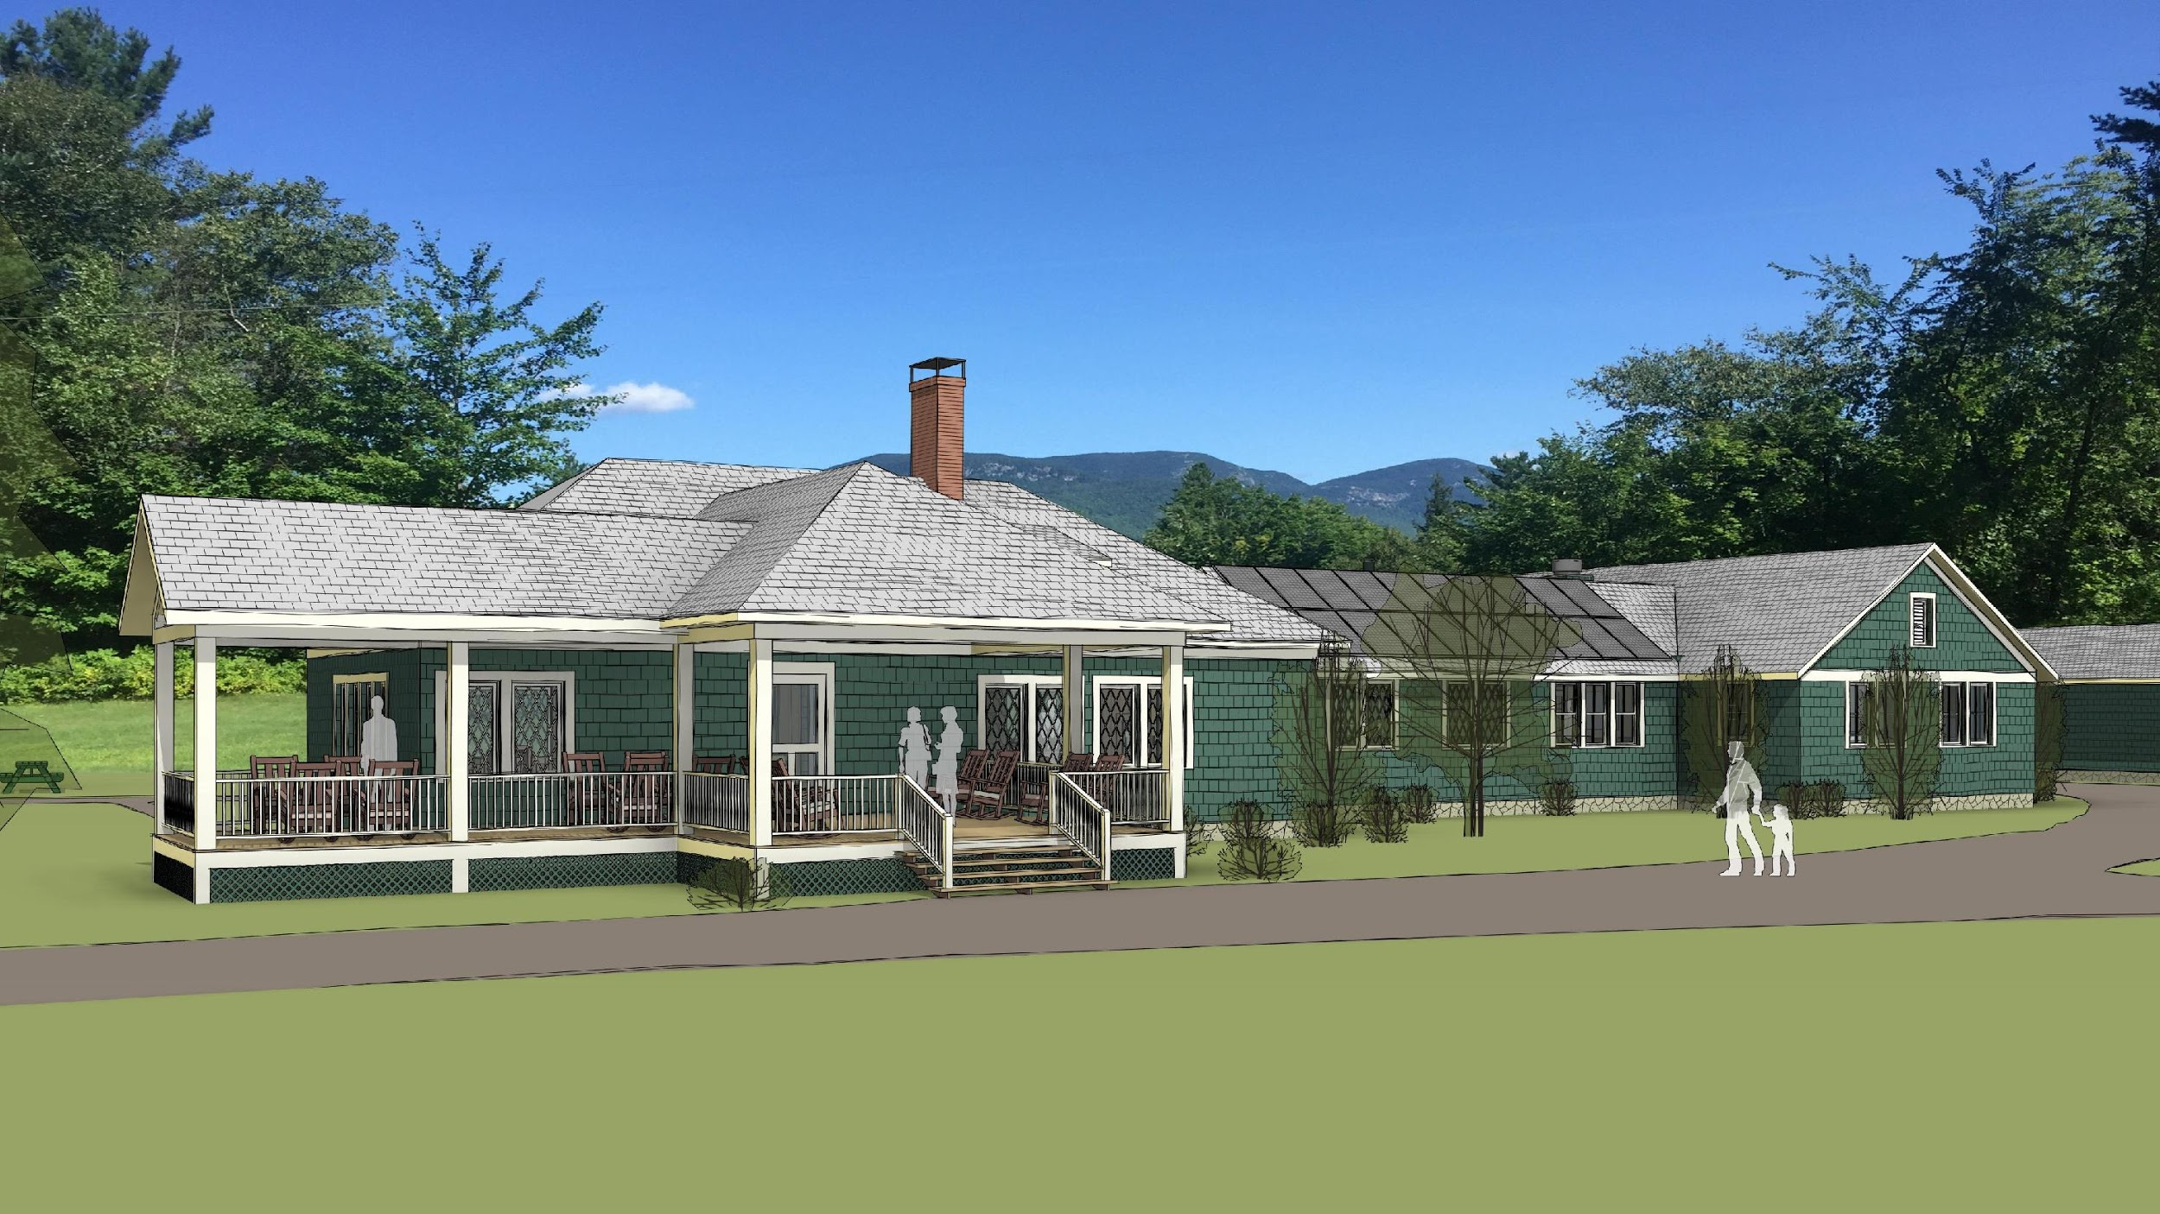
southwest view - with south and east facing solar panels
Notes:
Here is the same view with solar panels on both south and east roofs. What do you think? Solar panels on both roofs or just the east roof. Let us know at the end of the presentation.
Please Note: Solar panels are scalable in the sense that they can be placed on other roofs or on the ground. However, it may be much more costly to have a set of panels permanently located on the ground due to the additional support structure required.

Slide 40
AMC CRC Lodge Project Recap of Why?
Notes:
As we wrap up this presentation, let’s consider some of the main benefits and drivers of the East Plan.

Slide 41
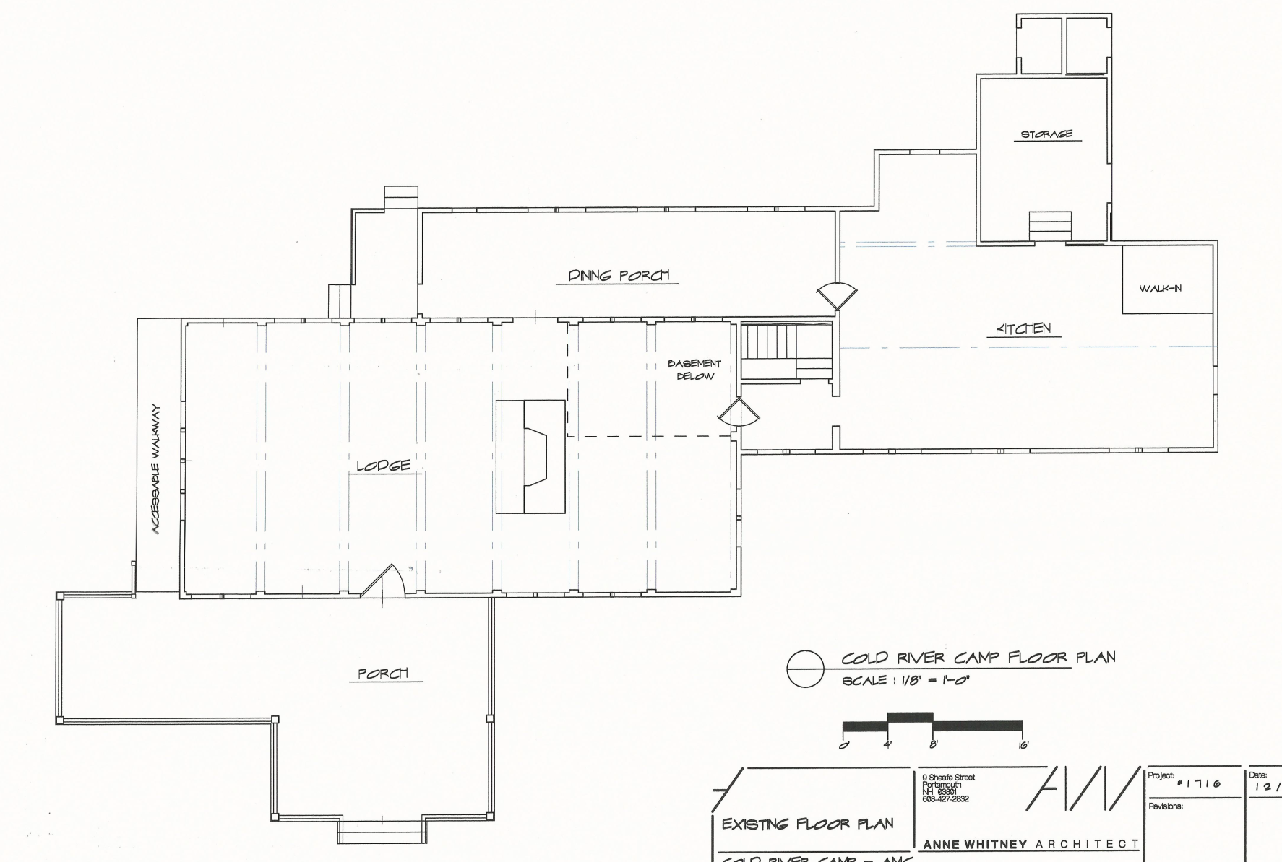
Why? Main Drivers and Benefits of CRC Lodge Project
Integrate Solar energy as a means of reducing carbon footprint
Address required structural repairs of dining porch
Improve guest bathroom availability and accessibility (ADA compliant)
Add dining room space (ADA seating, wheelchair access, more seating room)
Provide needed facility improvements while balancing:
Camp History, Experience & Aesthetics
Greater AMC Mission
Building codes
Diversity of uses
Financial considerations
Add living room social space
P
Modernize Kitchen to increase operating efficiency and enhance working environment
EXISTING LODGE
Notes:
It addresses required structural issues, adds dining room space and increases accessibility, adds living space, improves guest bathroom availability and integrates solar power WHILE balancing Camp History, experience and aesthetics, the Greater AMC mission, building codes, diversity of uses and financial considerations.

Slide 42
CRC Lodge Project When?
Notes:
What is our timeline for this project?

Slide 43
When? Timeline and Next Steps
 | 2019 |  | 2020 |  |  |  | 2021 |  |  |  | 2022 |  |  |  | 2023
 | Su | Fa | Wi | Sp | Su | Fa | Wi | Sp | Su | Fa | Wi | Sp | Su | Fa | Wi | Sp
Summer Seasons | 101 |  |  |  | 102 |  |  |  | 103 |  |  |  | 104
CR Community feedback
Develop feasible schedule
Finalize financial estimates
Finish Detail Design Plan
AMC Project Approval
Fundraising AMC Capital Campaign
Construction Phase 1 (tentative) |  |  |  |  |  |  |  |  |  | Kitchen
Construction Phase 2 (tentative) |  |  |  |  |  |  |  |  |  |  |  |  |  | Dining Room
We are here
Notes:
As you can see, we are at the beginning of a long process, which will, if it receives final approval, will not begin construction until perhaps the fall of 2022.
The Lodge Planning and the Cold River Camp Committees have both recommended pursuing the east design pending the following: 1. Feedback from CRC Community, 2. The development of a feasible schedule with its impact on Camp; 3. Good comprehensive cost estimate with impact on Camp Revenue; 4. Affordability, which includes using funds from CRC reserve fund and getting permission from the AMC to run a capital campaign to raise the remainder; and 5. Overall approval of the project by the AMC
We cannot solicit funds for the project until we have AMC approval. Construction will then be dependent on fundraising as we must have sufficient money to pay for the construction (from fundraising and part of the Camp’s reserve fund) before we can begin.
WE ARE CURRENTLY IN THE PROCESS OF GETTING AN ESTIMATE ON THE COST OF THE PROJECT, WHICH WILL BE NEEDED BEFORE MOVING FORWARD as well.

Slide 44
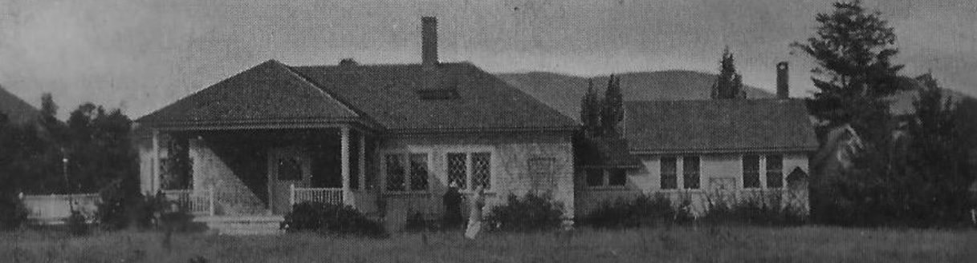
AMC Cold River Camp Lodge Project Update
Questions?
Notes:
Now we have some time for Questions/Comments?
We also encourage you to go the Cold River Camp Web page to submit more questions/comments to the Lodge Planning Committee directly. You can look under the “About CRC” for the Lodge Planning Projects” section where you will find a link to submit comments/questions.

Slide 45
AMC CRC Lodge Project Thank you!
Notes:
THANK YOU!

Slide 46
appendix 1:
materials
Notes:
The material in the appendix in the following slides is for reference only, not meant as part of the main presentation.

Slide 47
selecting materials / equip
durability / Long life (100 years)
local / regional materials
natural / bio-based materials / chemical content
recycled content / responsible extraction
low / no VOC’s
acoustic properties
occupant control
energy efficiency
temperature swings (unconditioned spaces)
aesthetics – “studied rusticity”
materials / equipment
Notes:
Here is some more information on guidelines that we will be focusing on as we are moving on to the construction phase of the project.

Slide 48
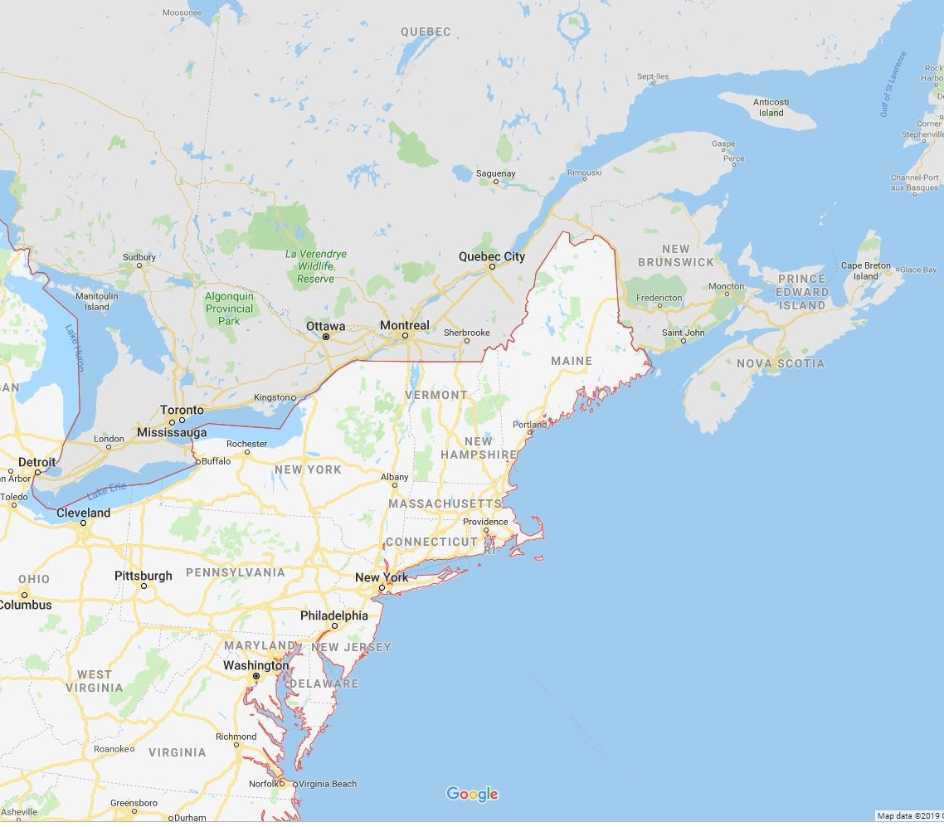
continuing the CRC tradition
100 mi
radius
500 mi
radius
local / regional
sourcing
of materials
and FF&E

Slide 49
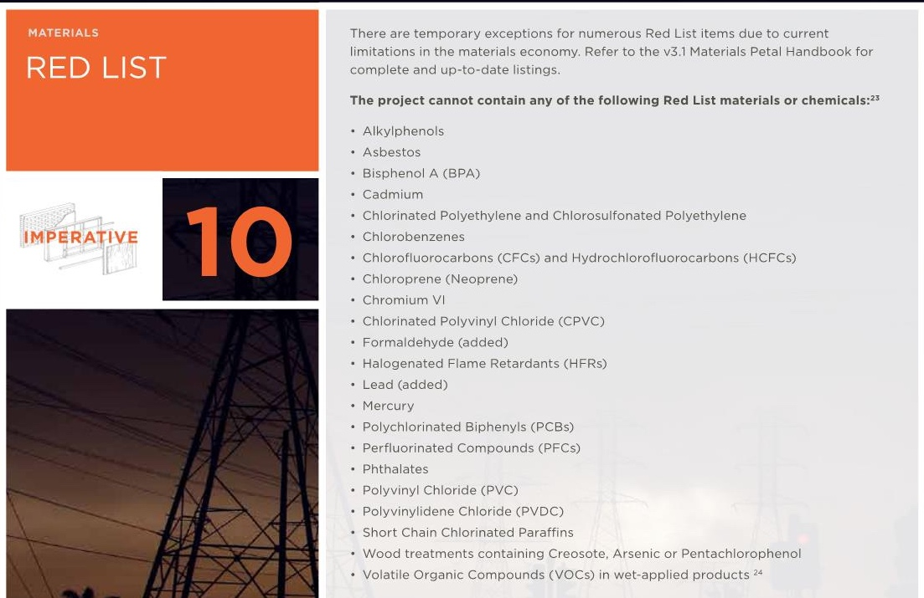
living
building
challenge
criteria
as guide
materials

Slide 50
exterior materials

Slide 51
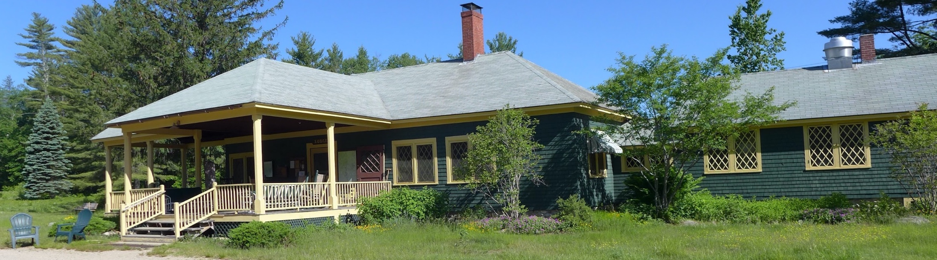
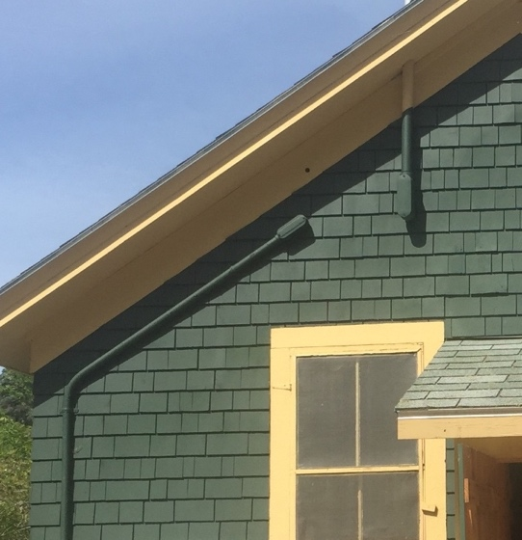
shingles
type: eastern white cedar
grade: A
exposure 5” +/-
paint color: green
wall
materials

Slide 52
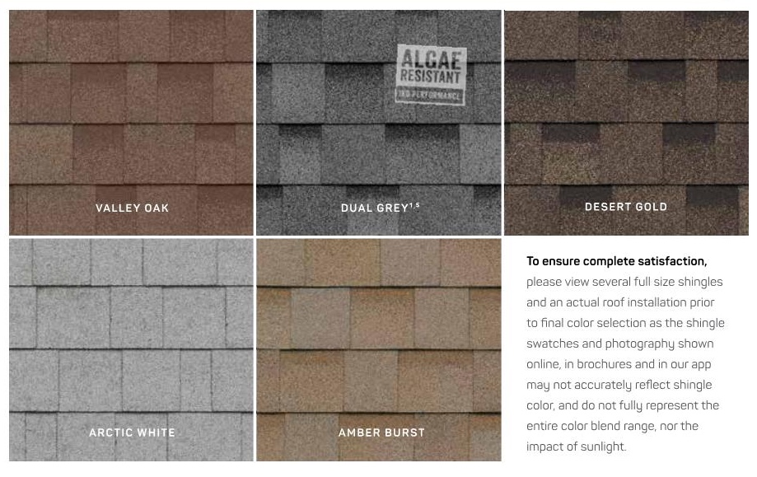
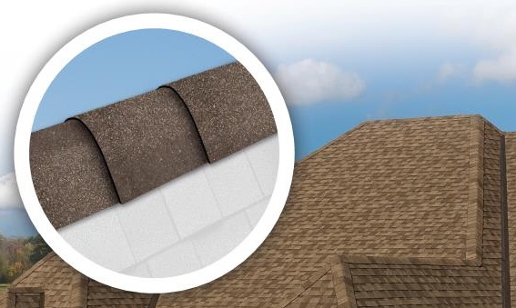
“cool colors” reduce heat gain. Select final color on-site with actual samples
IKO – cool colors
dimensional shingle
Light color can show algae stains (@ north side)
not recommended
roofing
materials

Slide 53

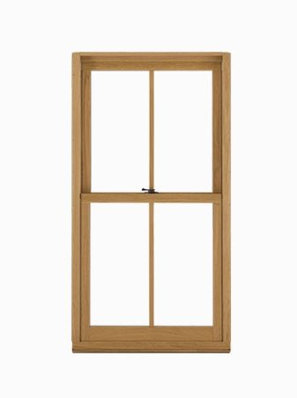
Qualities:
interior finish – stained wood
exterior finish – clad or painted?
factory made or regional wood shop?
glass – single pane
maximize north view
Winterizing/security
ease of operation by guest
clearance at tables
simple, long lasting hardware
glider (horizontal muntin)
double hung (vertical muntin)
window
materials
at least two potential window types.

Slide 54
interior materials

Slide 55
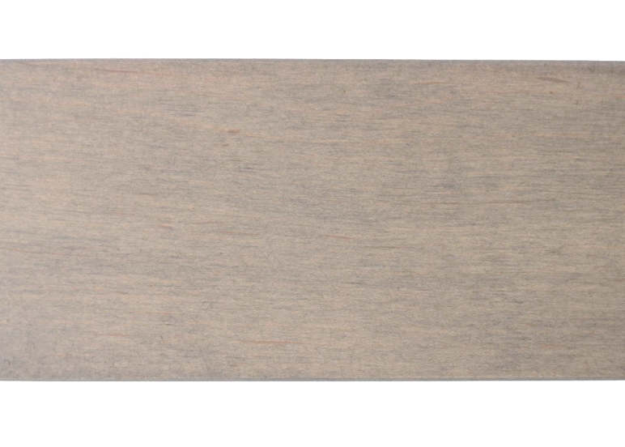

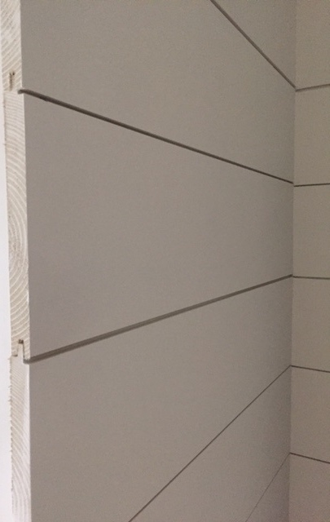
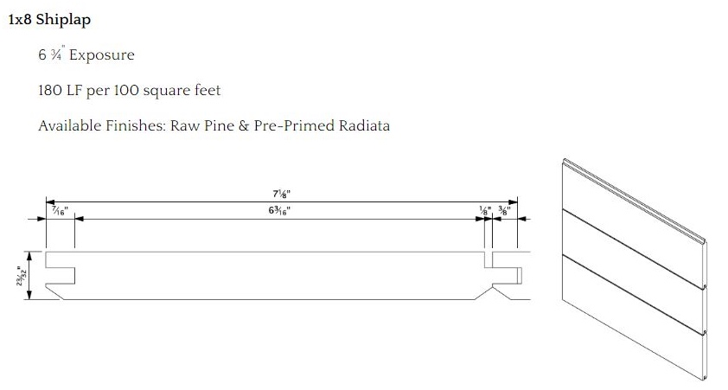
1/8” gap
mid tone stain on clear select eastern white pine
nickelback profile
dining room walls
materials

Slide 56
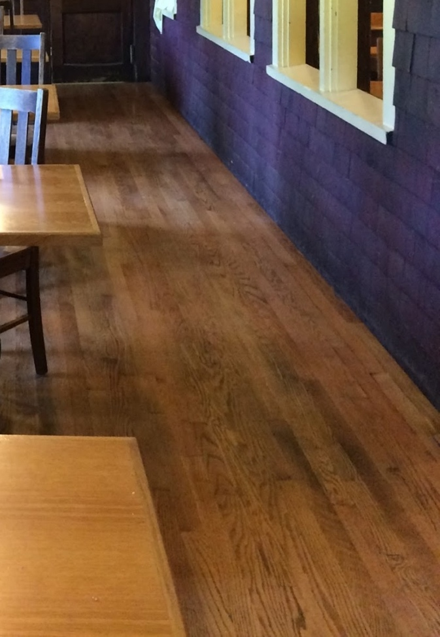
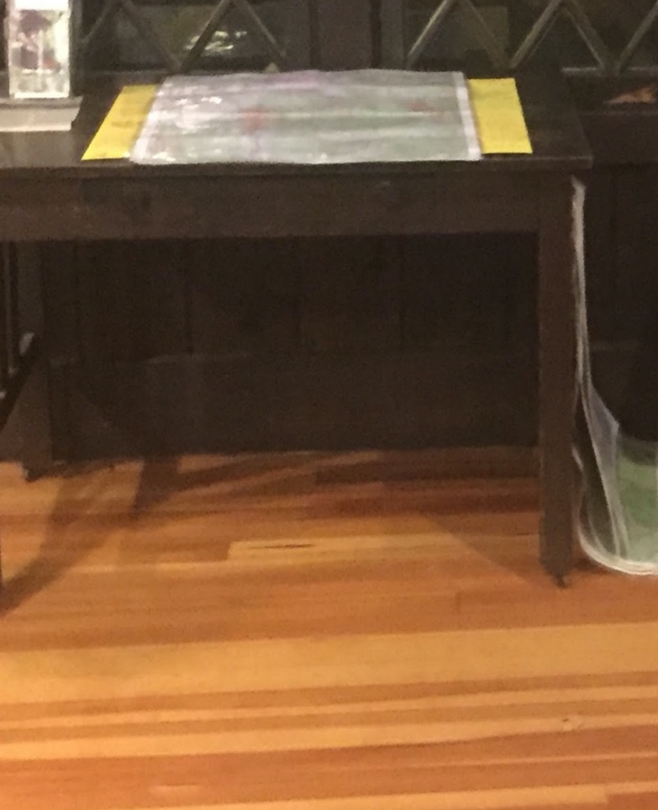
Floor decisions
northern hardwoods include:
white and red oak
maple
yellow and red birch
ash
cherry
hickory
walnut
Beech
Quarter sawn and rift sawn minimize movement due to moisture and temperature with changing season.
oak
douglas fir? (not local)
dining room floor
materials

Slide 57
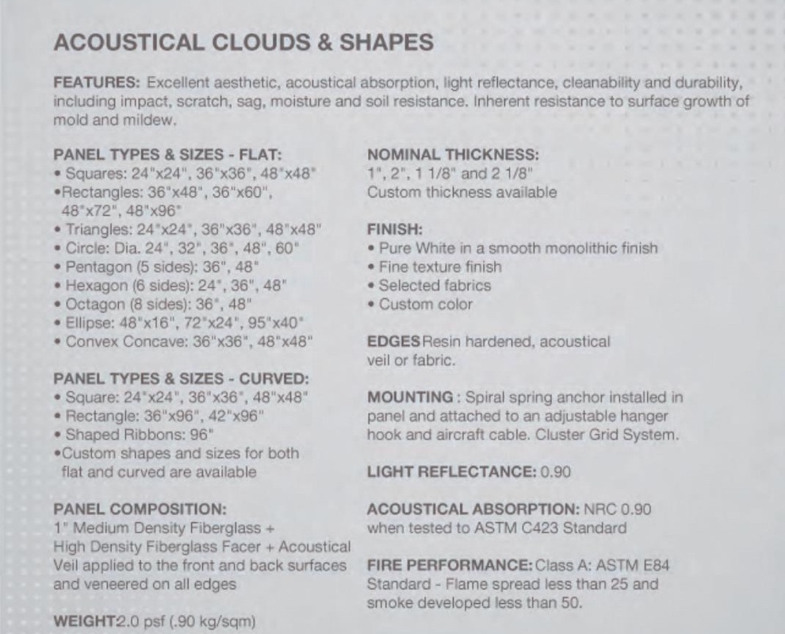
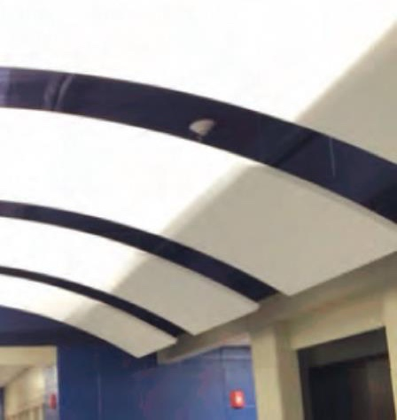
acoustical panel – high NRC .90
between joists
acoustics

Slide 58
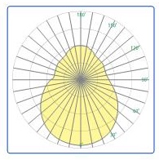
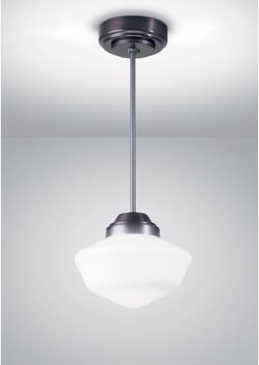
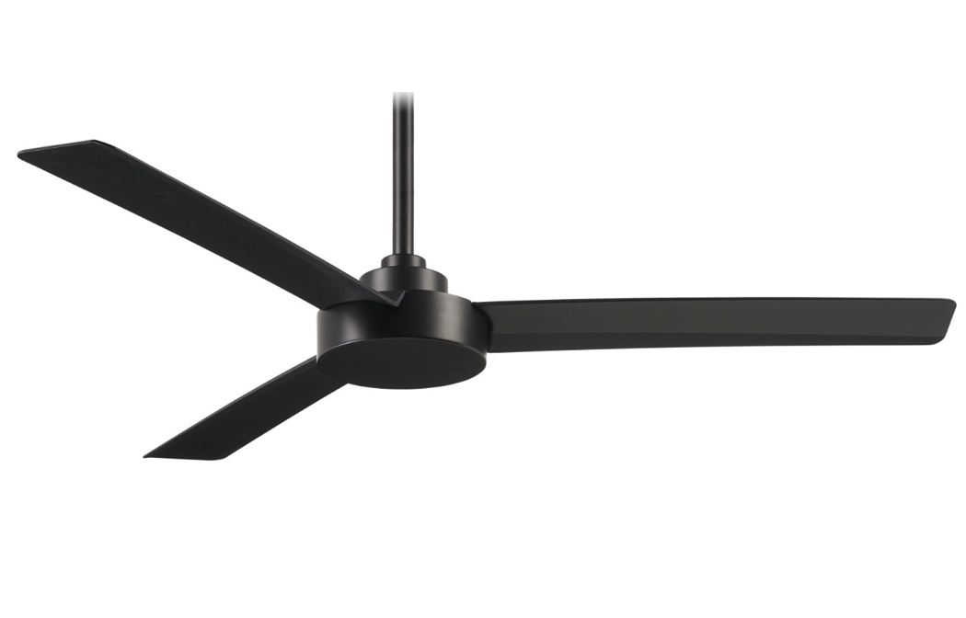
some lighting factors
photometrics – uplight
energy - LED
aesthetics - complimentary to historical fixtures
photometrics
fans – Minka-Aire “Roto”
lights – Pendant 14”, opal glass
dining room ceiling fixtures

Slide 59
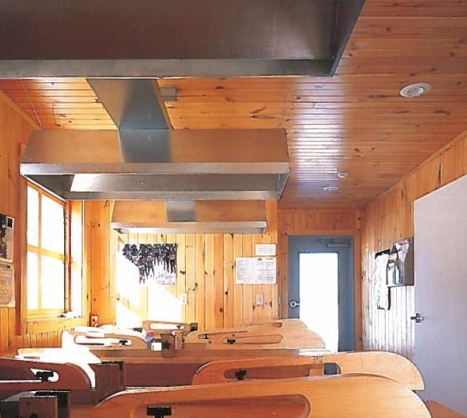
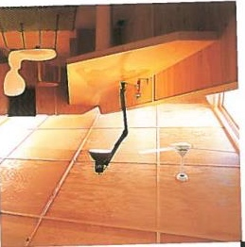
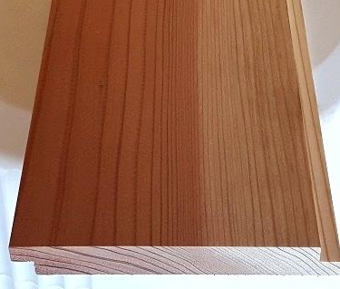
clgs – plank?
clgs – batten plywood?
walls – wood horizontal shiplap
kitchen finishes

Slide 60


dispenser type
backsplashes – stainless steel
kitchen finishes / ice machine

Slide 61



epoxy?
wood flrs w/ non-slip finish?
resilient wood flooring?
sheet vinyl?
kitchen flooring

Slide 62
appendix 3:
Extra Slides

Slide 63
What? Alternatives of Scope - Recap
Effort by Area | Minimum | Intermediate | Expanded
Kitchen | Keep same footprint. Replace/repair equipment. | Keep & expand footprint. Replace/repair equipment. Rebuild shed, raise floor. | Build new kitchen building Replace/repair equipment. Add grill within kitchen.
Dining Room | Keep existing. Repair porch | Keep and expand existing Rebuild and expand porch | Rebuild new Dining Room by repurposing old kitchen
Accessibility | Replace Jill with 1 ADA bathroom | Build 1 new ADA Bathroom. | Build 2 new ADA bathrooms
Gross Footprint | 2,650 ft² | 2,800 ft² | 3,425 ft²
Fire Code Building Occupancy | 103 No change, no triggers. | 114 Requires a firewall or sprinkler system | 139 Firewall between dining room and lodge
Living Area | No change. | No change. | Expand to entire Lodge.
Sustainability | Solar is scalable | Solar is scalable | Solar is scalable
Cost Estimate | TBD | TBD | TBD

